Slide 1




Serious Youth Violence:
Early Intervention and Diversion
Friday 29th November
Ricoh Arena, Coventry
@WestMidsVRU
@VR_Network

Slide 2

Facilitator for the day:
Andy Furlong

Slide 3
Welcome:
David Jamieson; West Midlands Police & Crime Commissioner
Lord Willy Bach; Leicestershire Police & Crime Commissioner

Slide 4
Policing Perspective:
Dave Thompson QPM; West Midlands Chief Constable
David Sandall; Leicestershire Assistant Chief Constable

Slide 5
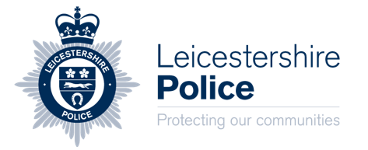
Violence
Chief Constable David Thompson
Assistant Chief Constable David Sandall

Slide 6
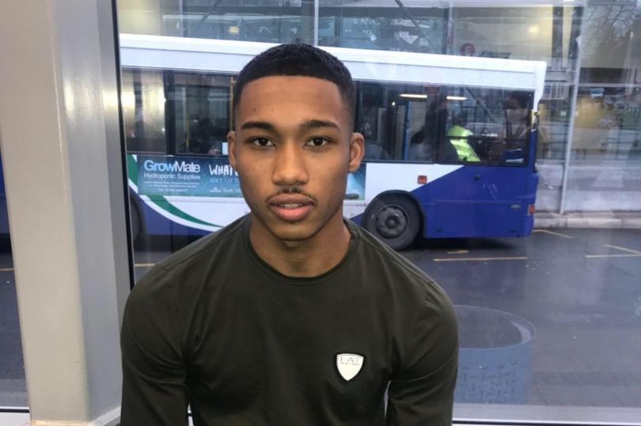

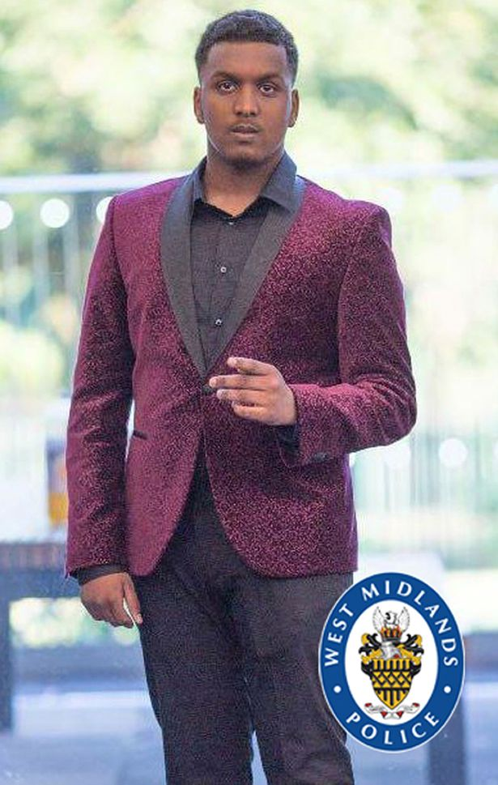
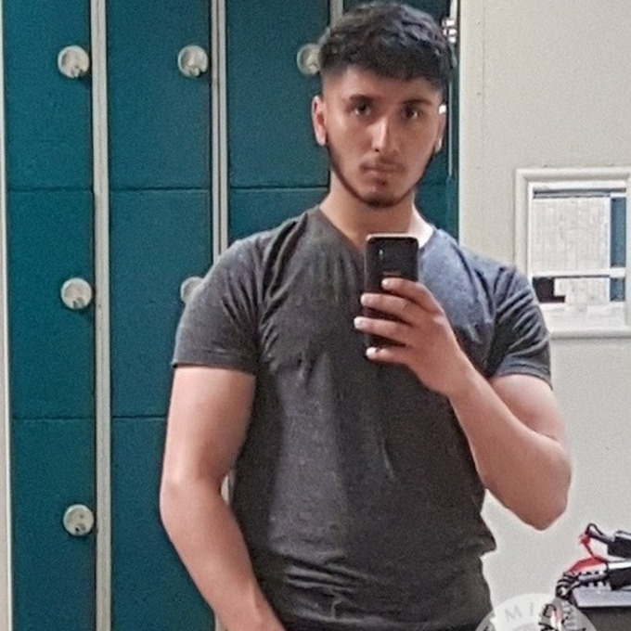
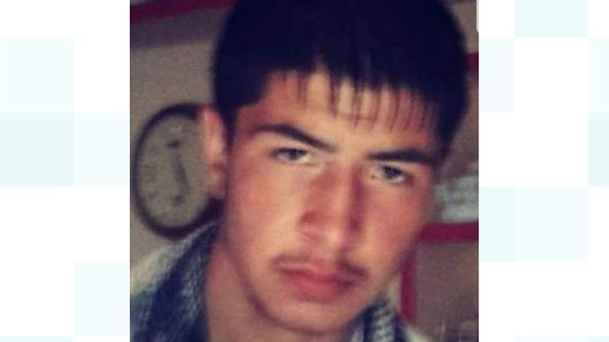
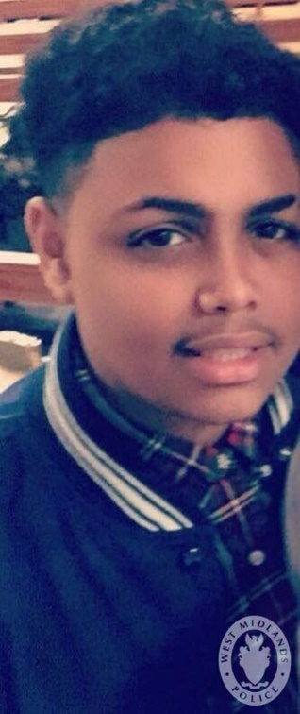
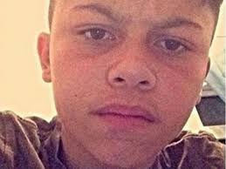
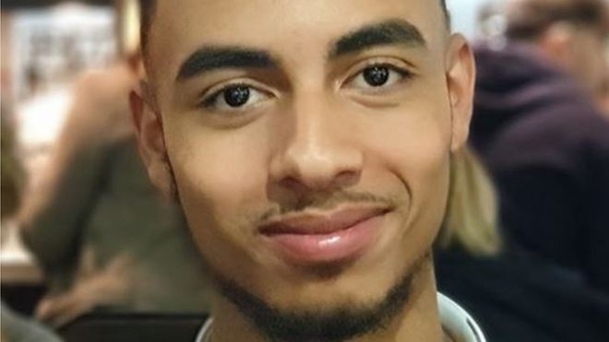
Violence
Notes:
Victims of knife or gun violence homicide 2018-19- Knife fight fist fights, drugs and gangs, robbery.

Slide 7
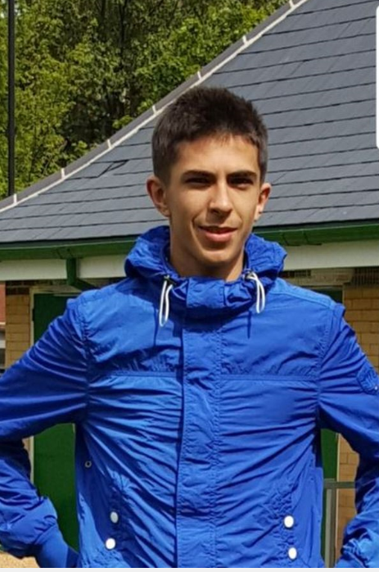
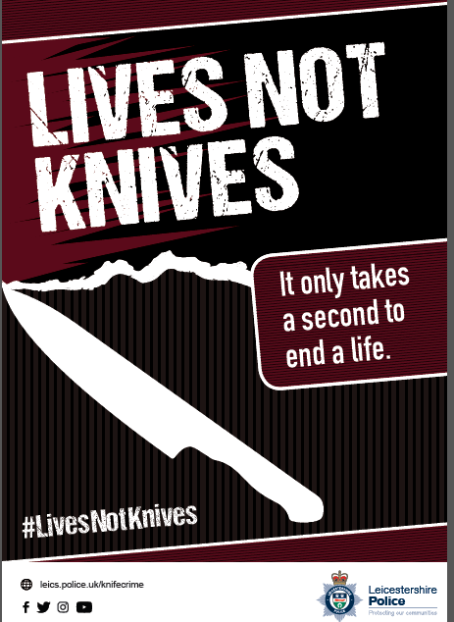
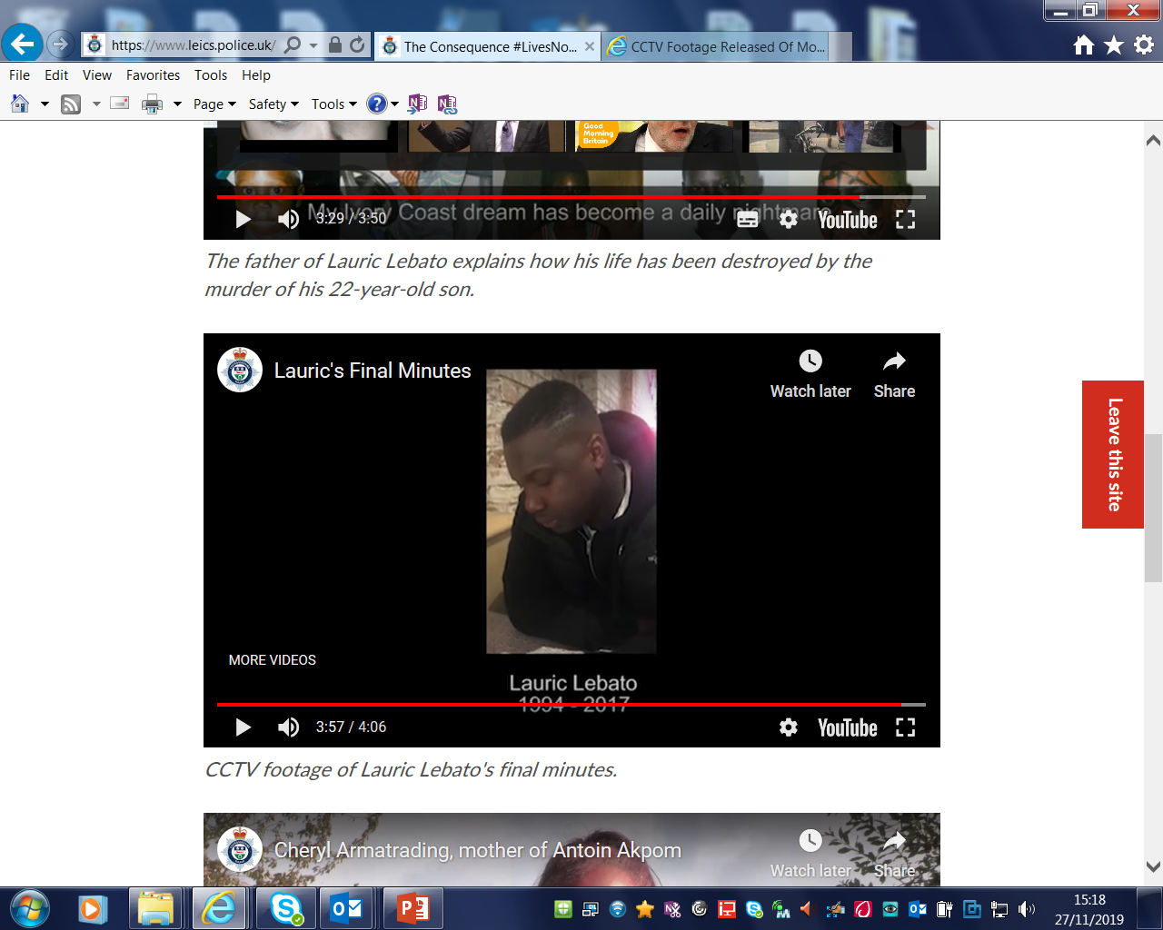
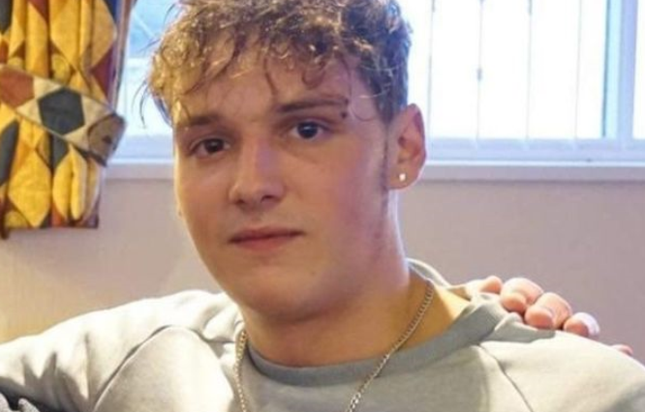
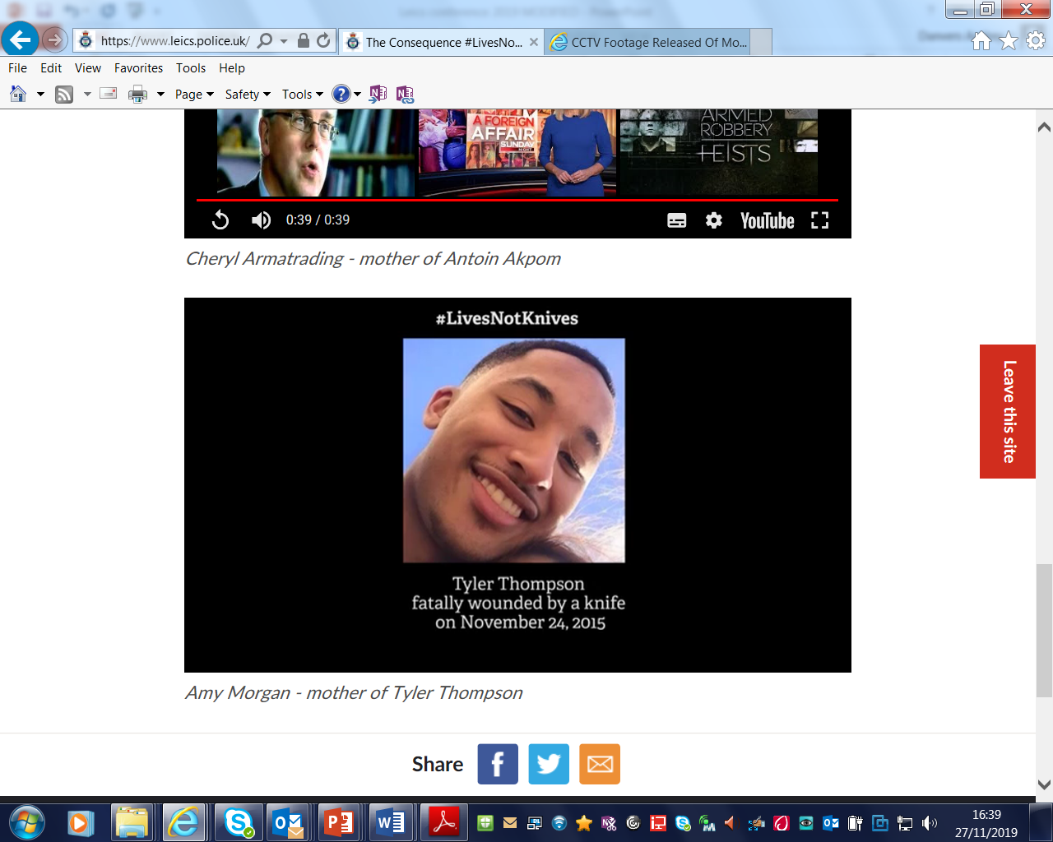
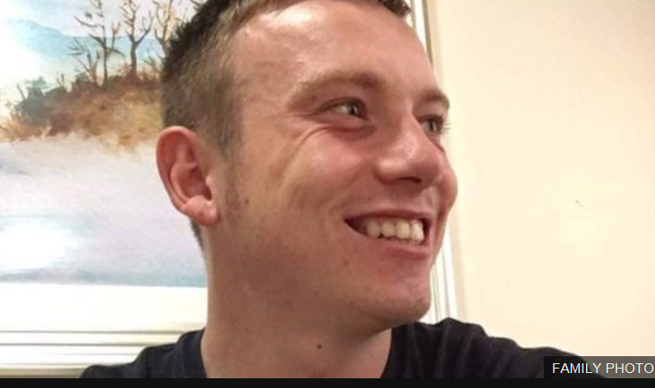
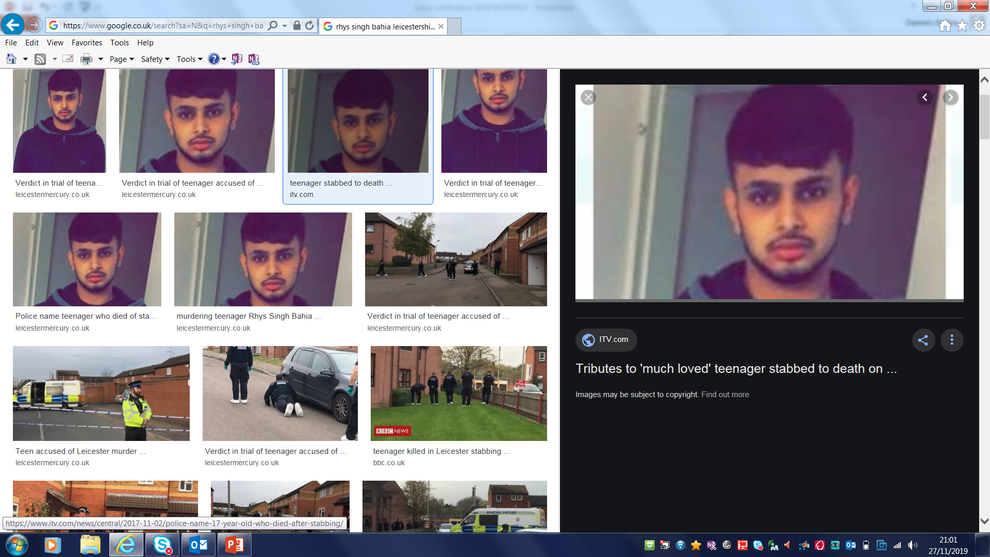
Victims of Stabbings

Slide 8
A perspective
Why has this become an issue?
What is the Police Approach?

Slide 9
Police focus “Under 25 Violence”.
A growing trend of knife carriage across young people for “safety” coupled with socialisation of violence.
Increase in violence around robberies.
Increased drug market related competition.

Slide 10










West Midlands Police Context
Homelessness
1st out of 42
Low Educational Attainment
1st out of 42
Unemployment
2nd out of 42
Deprivation
1st out of 42
Proportion of
Young People
(under
25s)
1st out of 42
Lower than National
Average Life Expectancy
Diversity
2nd out of 42
Notes:
Proportion of young people under the age of 25 is 35% - first out of 42 forces. lowest attainment of GCSEs in the country – English and maths GCSEs.
Worst in deprived areas
27% live in areas that are in the top 10% most deprived

Slide 11
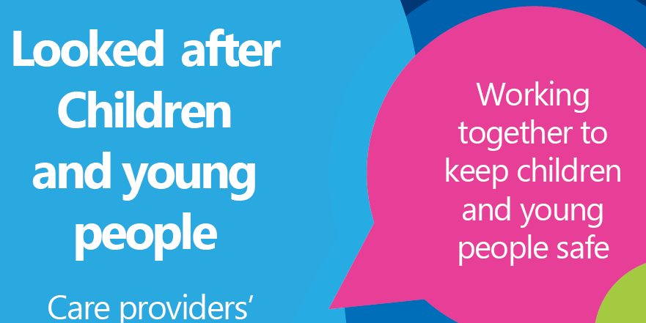
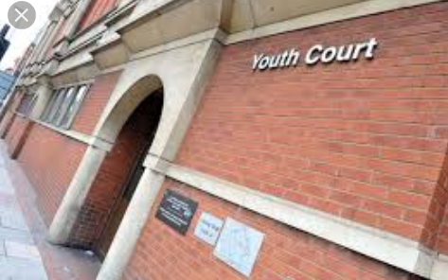

Leicester City – The Policing Challenges
The City of Leicester was ranked above the national average for England in the following areas;
    Children in care
    Children in the youth justice system
    Child poverty
    Violent crime hospital admissions
    The index of Multiple deprivation
    35% of people are living in 20% of the most deprived areas in England
    Leicester is one of the top 10 cities with the lowest weekly workplace earnings

Slide 12
Broader questions?
The socialisation of young people.
Inability to deal with conflict.
In education until 18.
24/7 connectivity.
Basic needs and aspirations.
Belonging.
Exclusions, off rolling, alternative provision.

Slide 13
Policy Issues for Policing
Complex drivers.
Less susceptible to traditional police interventions.
Long term strategy not short term tactics.
Limited evidence base of “What works”.
Capability to do more harm.

Slide 14
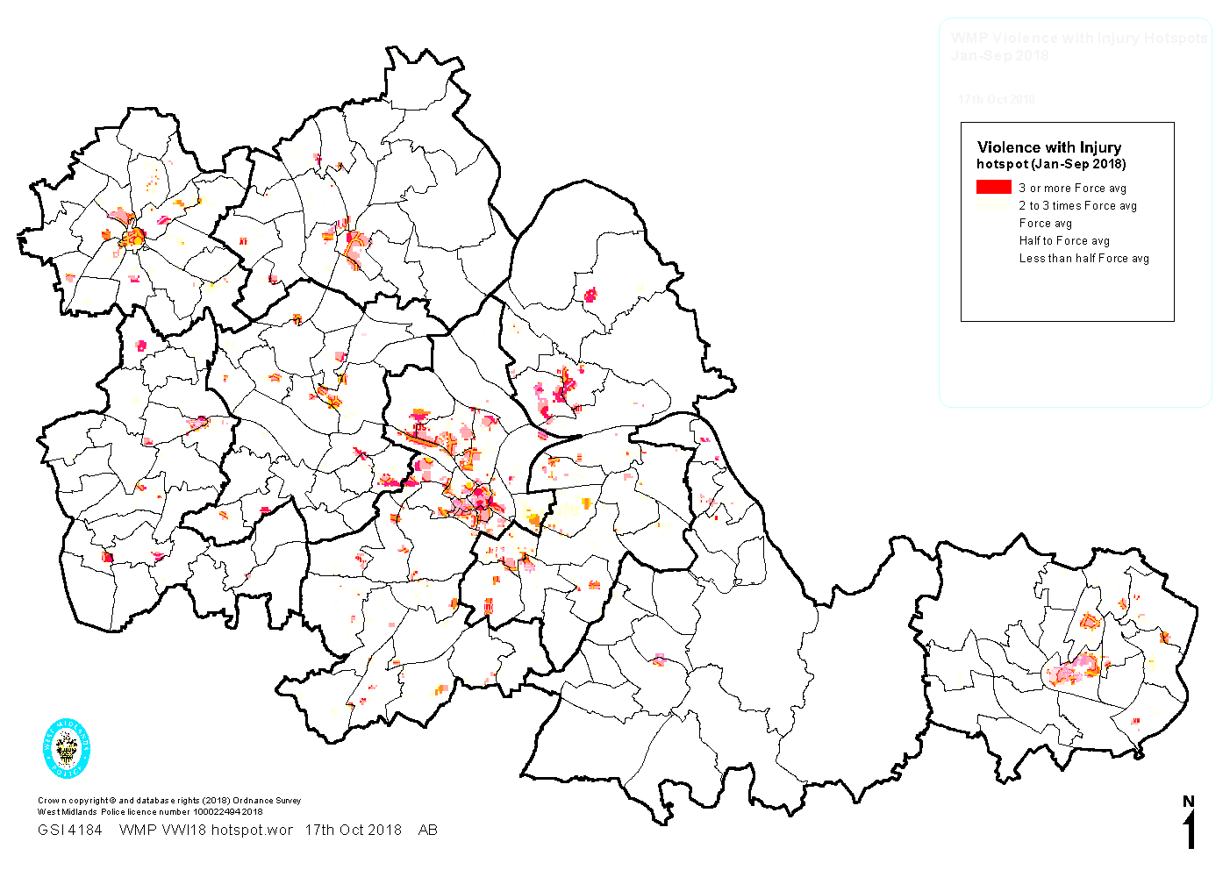
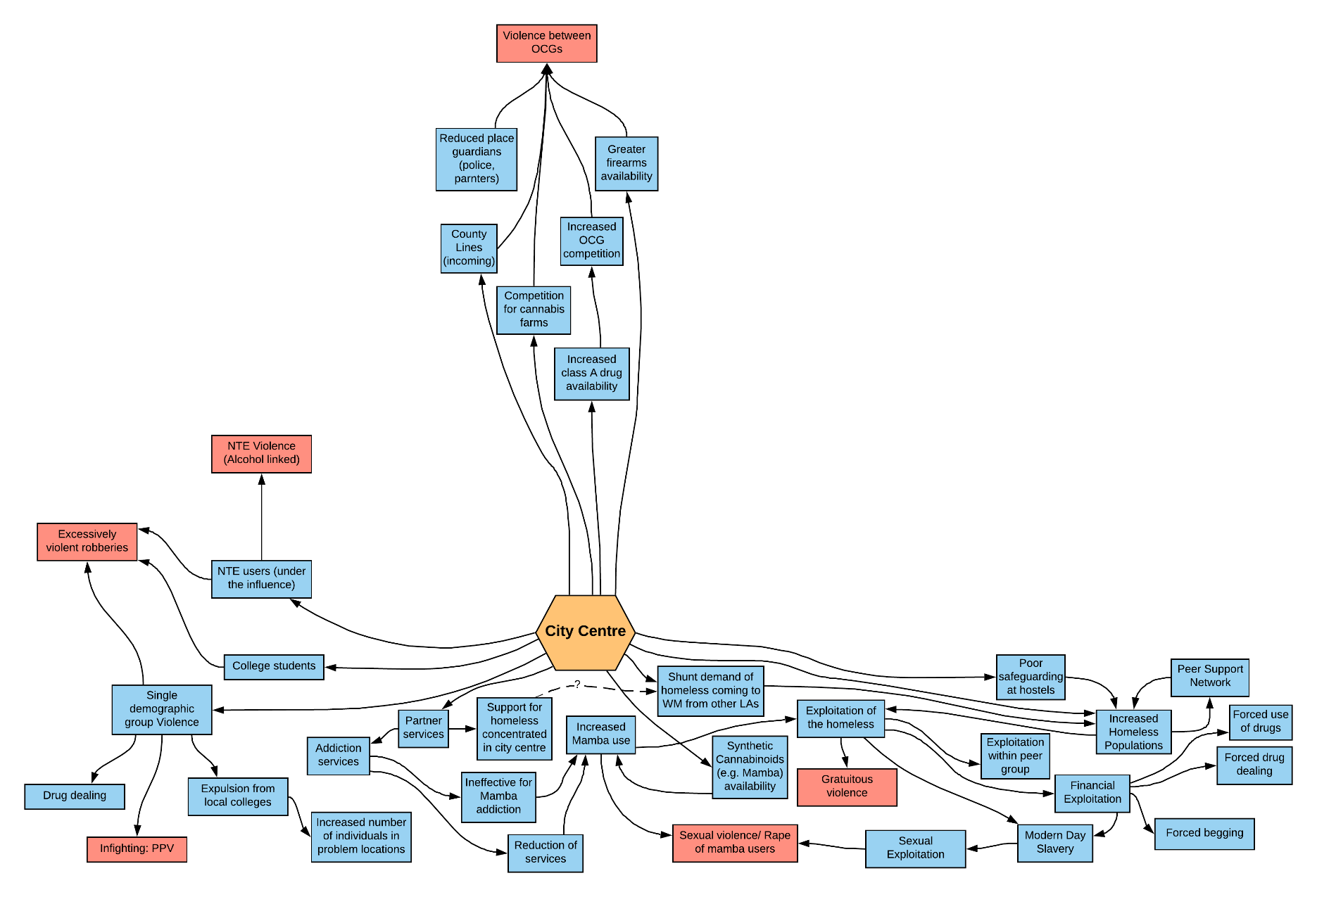

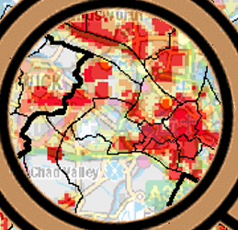
Causation Factors

Slide 15
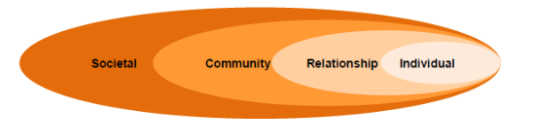
The ecological model of violence & prevention
Macro level factors | Factors based on community/ social environments | Factors from peers, family, partner which shape an individual | Personal history factors which increase likelihood of becoming victim or offender
Inequalities in society (gender, race..) | General tolerance of violence, inequality | Poor parenting/ emotionally unsupportive | Victim of child abuse
Cultural norms which permit/ support violence | Poverty Scarcity of good jobs | Conflict in parental relationships/ separation from parents | Individual psychological factors
Economic environment & economic inequality (weak economic safety net) | Weak sanctions against perpetrators | Friends that engage in violence/ harmful behaviour | Abuse of substances
Poverty | Inadequate victim care provision | Low socioeconomic household | Harmful attitudes/ beliefs
Notes:
Diagram describes risk factors for violence at different levels
We need to work at all these levels
Requires everyone to ‘do their part’ – solutions are across organisations

Slide 16

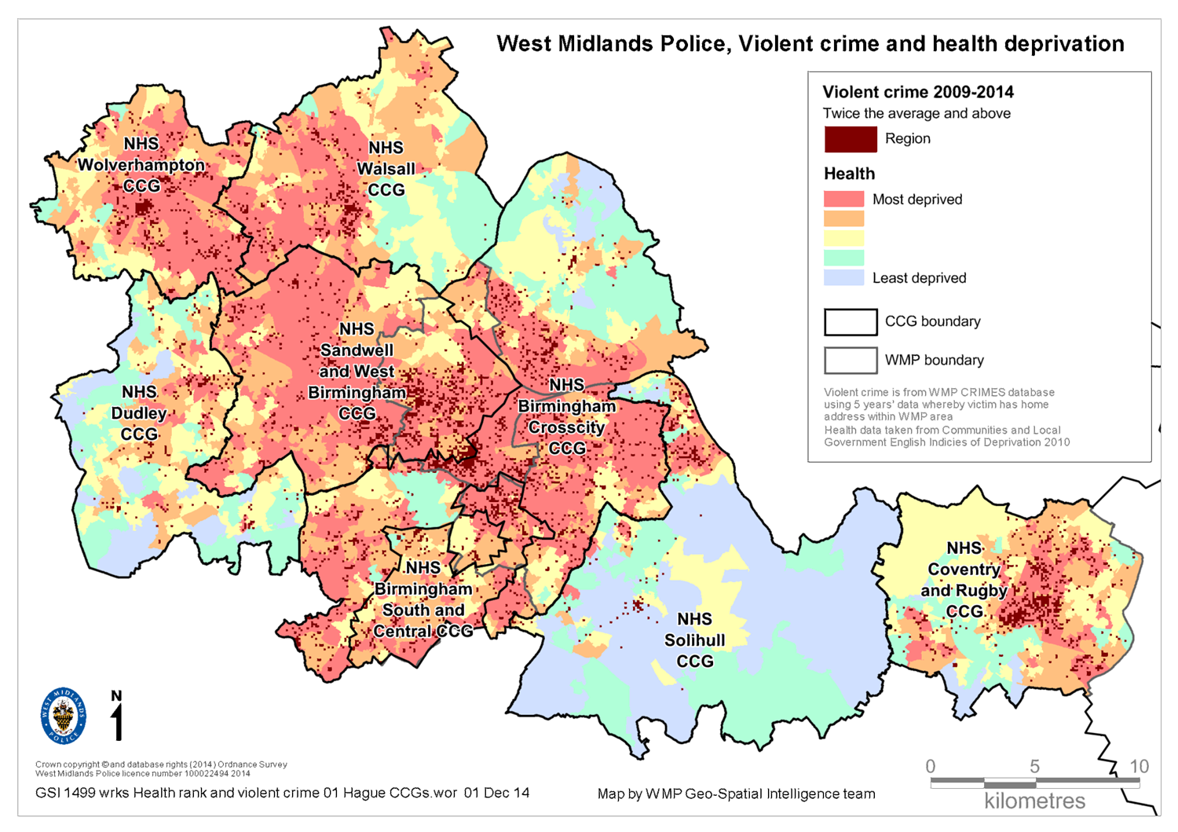

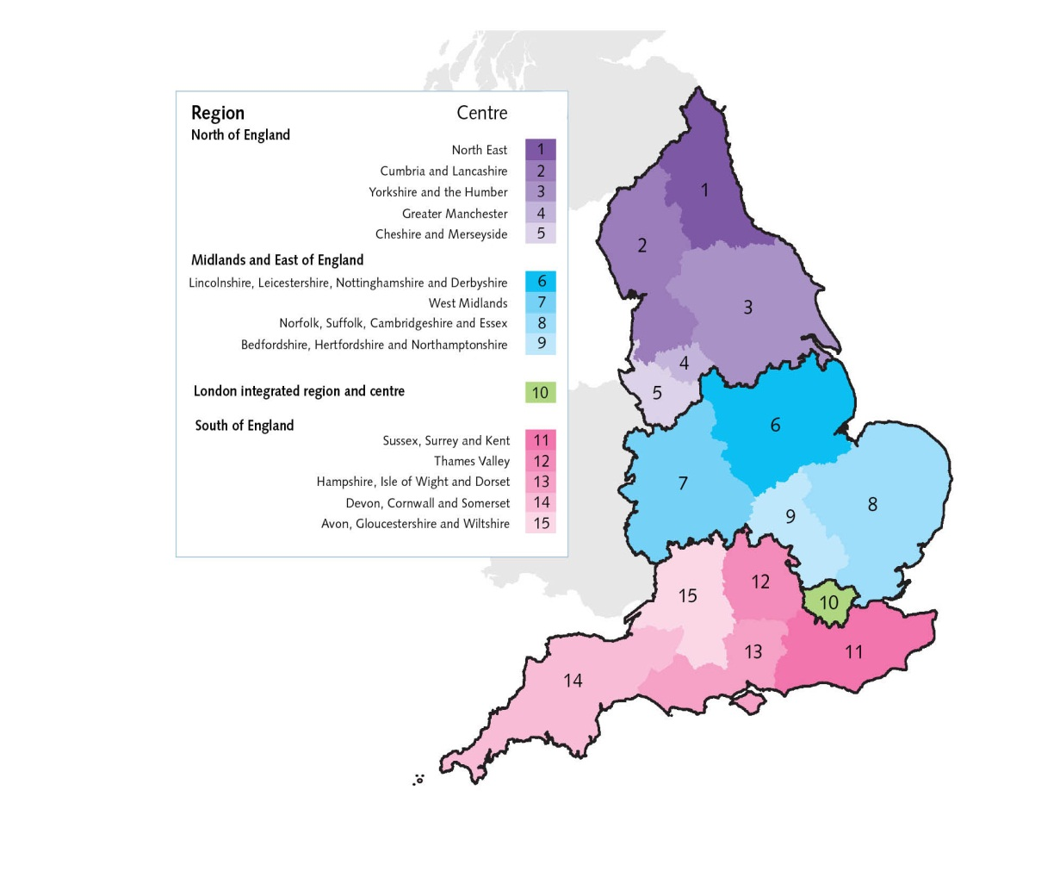

West Midlands Police, Violent Crime & Health Deprivation
Notes:
Rates of serious violent crimes continue to be of concern across the country including in the West Midlands (HM Government, 2018)
The Government’s Serious Violence Strategy was published in April, 2018, emphasising:
1. Tackling county lines and misuse of drugs
2. Early intervention and prevention
3. Supporting communities and local partnerships
4. Effective law enforcement and criminal justice response
Map: Show that violence is strongly related to inequalities, with the poorest fifth of our society suffering rates of hospital admissions for violence five times higher than those of the most affluent fifth.
The Alliance began with conversations between WM PHE centre director and WM chief constable, and began a journey into working across the system in taking a public health approach to prevention of violence and adversity
First task was producing an intelligence report, ‘Protecting People Promoting Lives’, by seconding a WM analyst into PHE to collaborate and pool data. Recommendations from this formed the Alliance

Slide 17
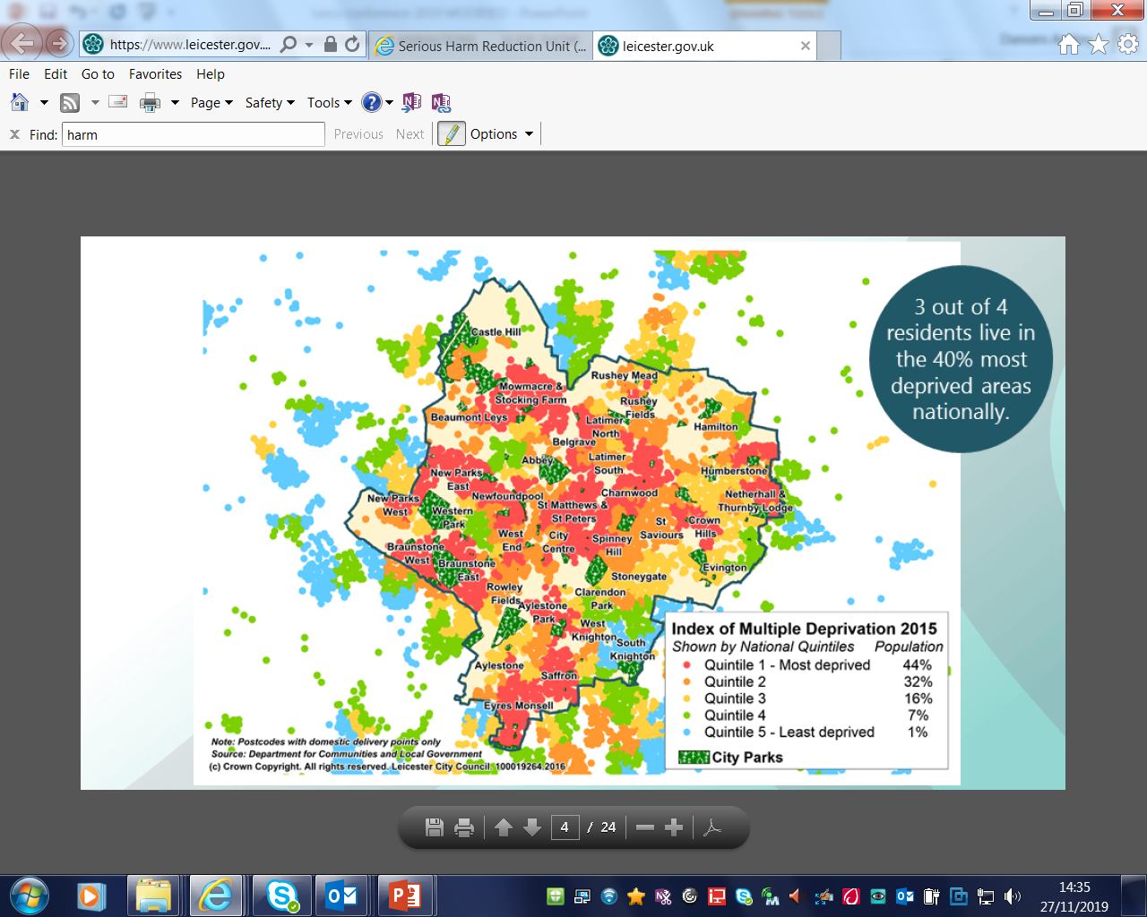
Leicester City – Crime & Deprivation

Slide 18
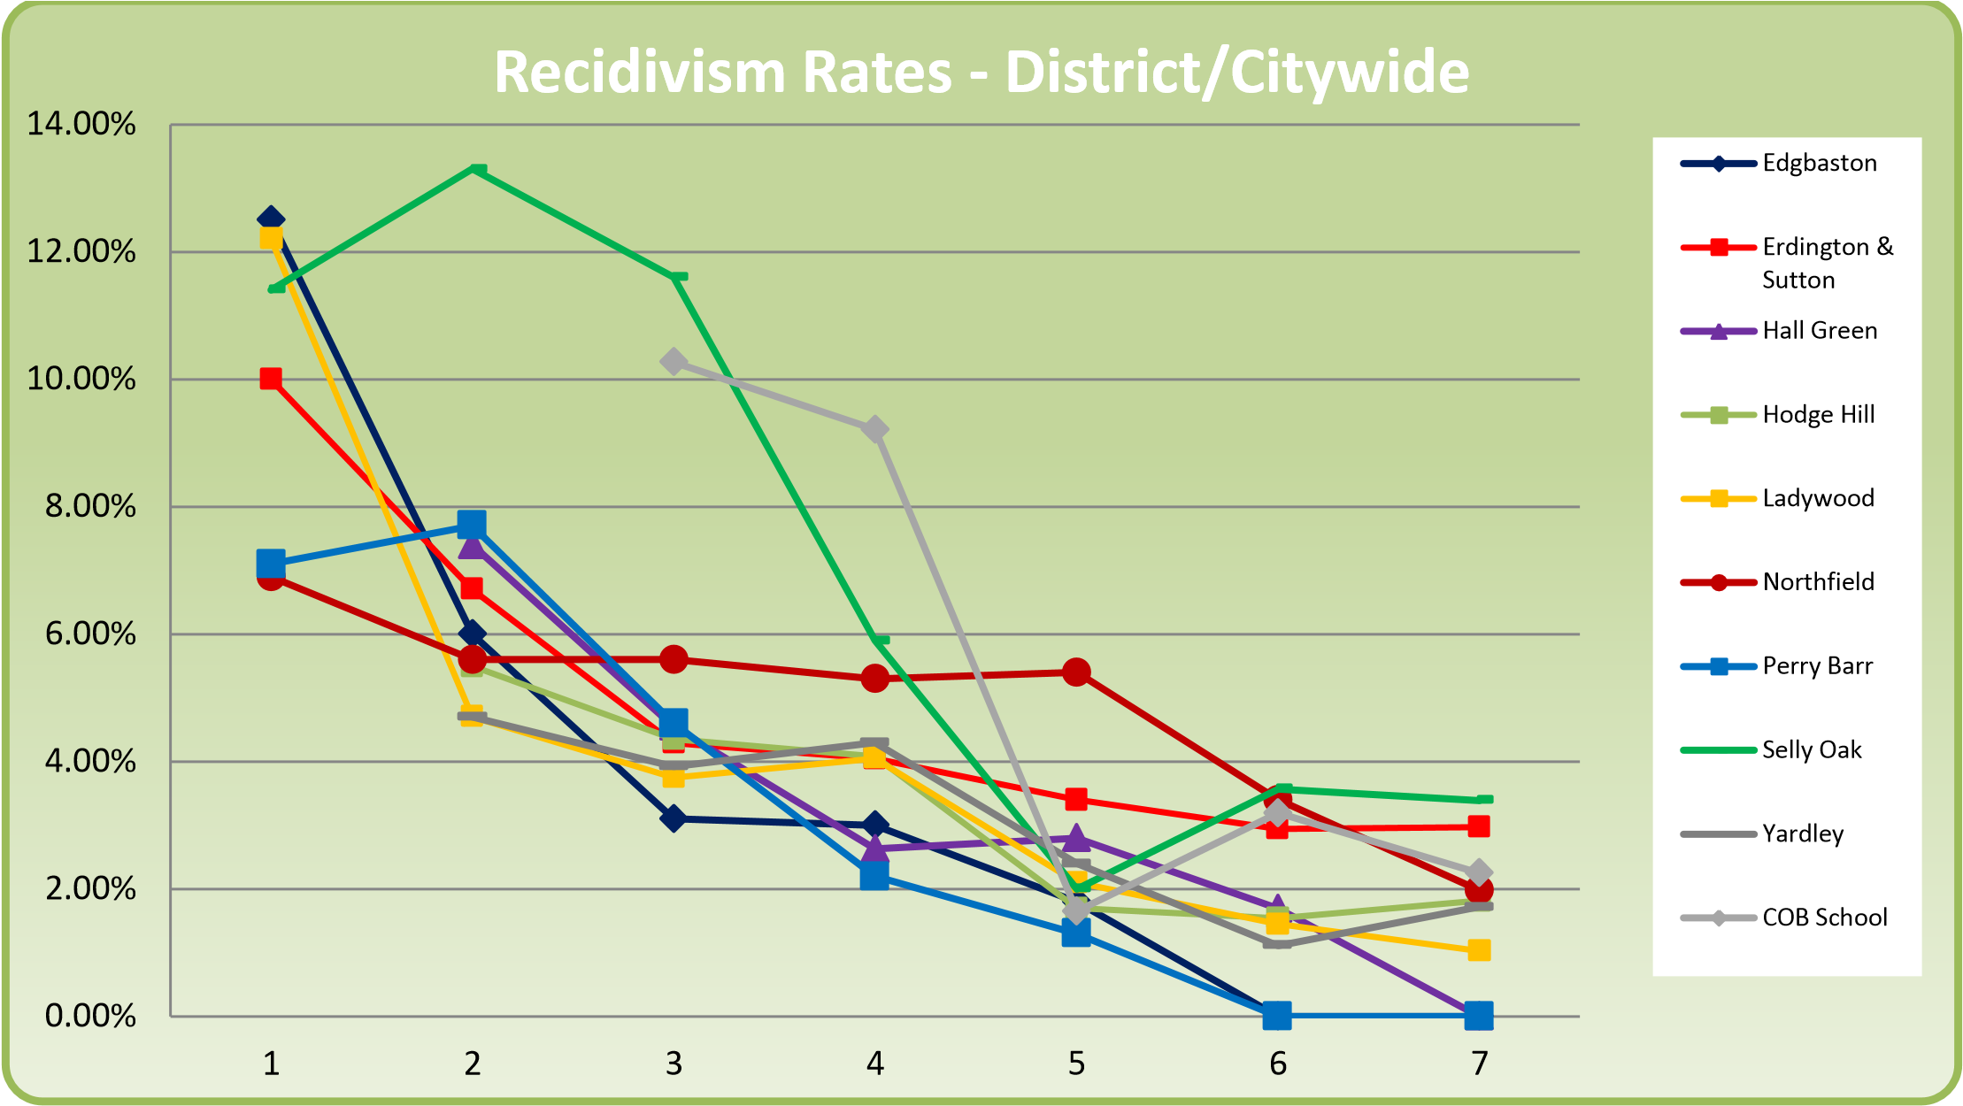
West Midlands Police
Police and Schools Panels
Empower schools to play a key role in keeping young people in education and out of the criminal justice system
Early intervention, prevention and diversion of young people at risk of offending or criminal exploitation via the two-way data sharing agreement
Notes:
West Midlands Police and Schools panels are located in:
Birmingham, Coventry, Solihull, Wolverhampton and Sandwell.
Objective of Police and schools panels is to empower schools to play a key role in keeping young people in education and out of the criminal justice system. This approach has established strong effective and efficient joint working relationships between senior decision makers form eth police, educational institutions (i.e. secondary, alternative provision FE and in some areas this has extended to primary schools panel) and partner agencies. Thus, there is consistent and proportionate engagement between police and schools.
Core activities of Police and schools panels include:
Early intervention, prevention and diversion of young people at risk of offending or criminal exploitation via the two-way data sharing agreement
Accountability and strategic over-sight of the work of neighbourhood police teams in schools and response ‘health check’
Sharing with schools free resources and offers of support, both from West Midlands Police and external partners
Some feedback from schools and partners includes:
“In 18 years as a Head teacher, this is the first time - through working in this panel - that I’ve been able to work with the police for the benefit of the young people in our area.”
Jim Foley, Head Teacher, St Thomas Aquinas School and Chair of Northfield Constituency Schools and Police Panel
“The school’s work to keep students safe and secure is outstanding. Students say they feel safe in school. The school works effectively with a range of external agencies. For example, school staff are part of the local police panel, so they are aware of any student in the community who may be at risk and are able to provide specific support.”
Source: OFSTED Inspection report
“I just wanted to say the work you guys do at these police and school panels is amazing…I think the panels are a brilliant idea and concept and obviously only works with the schools’ involvement and honesty but the relationship it encourages between police and schools is an incredible one…I really admire the work you guys do for youth and community…”
Natalie Cox - commissioned by the PCC to deliver stop & search workshops to young people
Turves Green Boys’ School
Case studys include:
A pupil appeared on the database having been involved in a serious assault of an older, very‐vulnerable student. The Head Teacher spoke to him about the incident, and telephoned his mother to get clarity on the situation. The Head Teacher learned that the pupil’s father had died of leukaemia, shortly before he arrived at the school; this is something that the school were not aware of previously. The Head Teacher put him on report, offered him support and ensured that the school monitored his behaviour much more closely. The Head Teacher reported back, “I'm delighted to say when I was seeing students to celebrate their success this year; for the first time [Child A] was amongst their number. He has turned his classroom behaviour around and managed to gain 100 commendations, something not achieved by the vast majority of pupils. He was really very pleased!”
Missing/Absent data empowers schools to identify YP at risk of CCE, CSE
“It may seem ‘small’, but it has been very significant for 3 young people and their mother. A student at KNBS in Year 9, with an exemplary record in school; hard working, polite and achieving well featured on an ASB Police Panel spreadsheet during the latter part of 2017. He was recorded as missing then returned. As a school we spoke to the boy who explained the reasons for going missing, which was a family row. We also spoke to his mother who was very defensive but did verify the situation. Over the next fortnight, as a school we liaised with the primary school where two younger siblings attend. There were concerns regards how mother was presenting. Through further meetings with mother it materialised that she was experiencing D.V. The young man at KNBS was immediately placed with paternal aunt. A Section 17 plan was established for the family, this has resulted in the DV perpetrator moving out of the family home and contact arrangements put in place for the younger siblings. Our student is on a CIN plan, still residing with his aunt and attending KNBS. He is far happier and more importantly, safe. He has regular contact with our student social worker and school nurse. His step father is now attending a DV perpetrators course. Mother is on the Freedom project and a referral has been made to the SWEET project for parenting support.”
Recidivism Rates:
As we close off year 7 and prepare for the start of year 8 we have the opportunity to review data from the last 7 years, to see how the work of the 9 district panels sits alongside the recidivism rates (on a district by district level, against a benchmark of citywide performance).
Reducing recidivism is multi-faceted, with many influencing factors. Whilst the panels cannot lay claim to reductions, the work of the panels can be tracked over time to draw clearer data inferences.

Slide 19
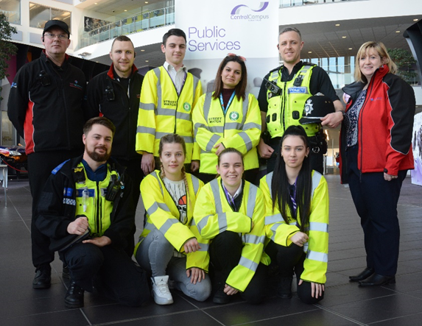
Streetwatch Schemes
Streetwatch west midlands started in Jan 2018 and we now have 140 schemes across the whole of West Midlands. Made up of 1200 members of the public and supported by 300 police staff mainly PCSO’s.
Community led initiative by the community for the community supported by WMP. Where members of public volunteer to patrol their locality in small groups to make the area cleaner and safer. Minimum of two hours per month. It is about citizenship, not policing.
Eligibility for any person aged 18-80 years. We now offer colleges opportunity to patrol with students aged 16 and 17 with tutors/lecturers. To get involved email Streetwatch@west-midlands.pnn.police.uk or twitter @streetwatchWM

Slide 20
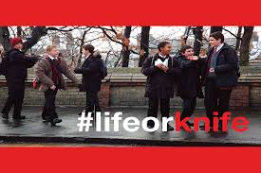

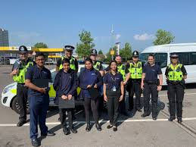
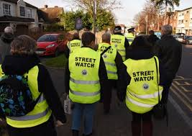

West Midlands Police
Notes:
Life or knife
The #lifeorknife campaign, which has been informed by the region’s schoolchildren, teachers, police officers, doctors, paramedics and members of the Police and Crime Commissioner’s Youth Commission, encourages children to talk about knife crime with parents, teachers and peers.
The campaign is aimed at children aged 14-16 and is split into three main parts.
• Schools talks
Supporting the PCC funded ‘Precious Lives’ school inputs is a new schools pack that allows PCSOs and police officers to talk to a larger number of schools about knife crime.
The pack includes hard-hitting facts about knife crime, true stories, a video shot with the support of local paramedics and doctors, charity videos and links to local support agencies
.
• A ‘How to talk to your child about knife crime’ video for parents
Distributed across Facebook, this video is a helpful guide about how to talk to a teenager about this difficult and emotive subject and what to do next.
• Social media content
Street watch
Streetwatch west midlands started in Jan 2018 and we now have 140 schemes across the whole of West Midlands. Made up of 1200 members of the public and supported by 300 police staff mainly PCSO’s.
Community led initiative by the community for the community supported by WMP. Where members of public volunteer to patrol their locality in small groups to make the area cleaner and safer. Minimum of two hours per month. It is about citizenship, not policing.
Eligibility for any person aged 18-80 years. We now offer colleges opportunity to patrol with students aged 16 and 17 with tutors/lecturers. To get involved email Streetwatch@west-midlands.pnn.police.uk or twitter @streetwatchWM
Cadets
The new scheme was launched in September 2017 and initially saw the establishment of groups at schools in Birmingham and Sandwell. This was soon followed in Coventry, Dudley, Solihull, Walsall and Wolverhampton.
The scheme recruits 13-17 year olds, from a diverse range of backgrounds, and provides them with unique opportunities to gain experience and insights into the force. Unlike its predecessor, this scheme is not a recruitment tool, but is about creating active citizens, engaging with our communities, and giving our young people opportunities to help others and learn new skills.
WMP Cadets are provided with a uniform, are organised into groups of up to 30 members, and are expected to attend unit meetings every week during school term time. There is no charge in being a cadet – everything is supplied for free, including the uniform and any trips.
There are currently 10 Cadet units, 55 leaders (14 more leaders going through the recruitment process) and 210 cadets. The expansion continues at a pace.

Slide 21
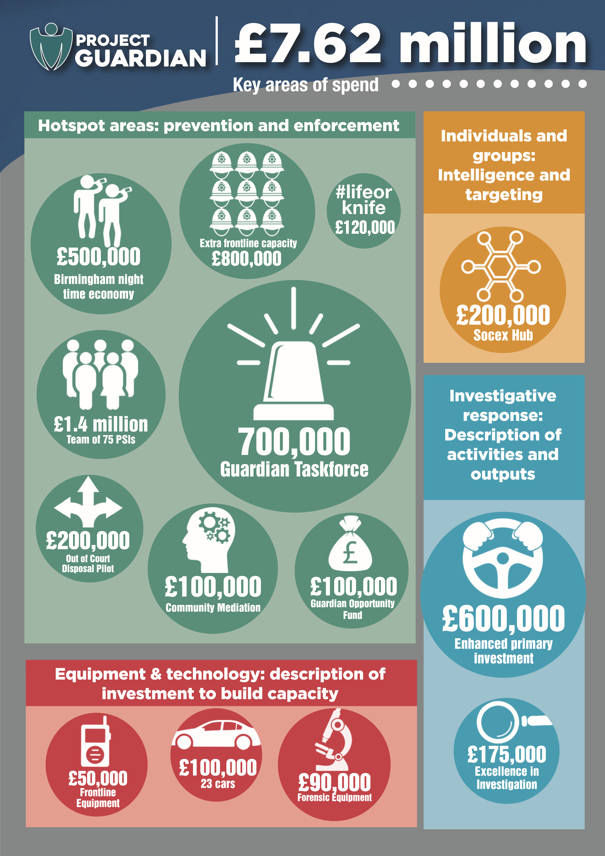
Project Guardian

Slide 22
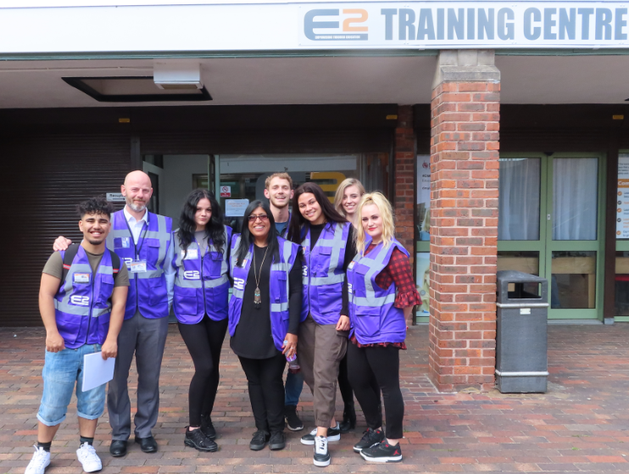
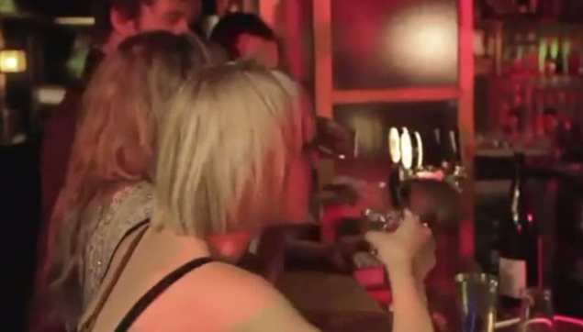
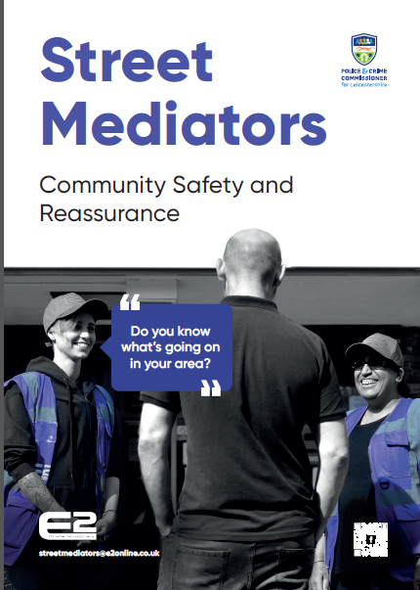
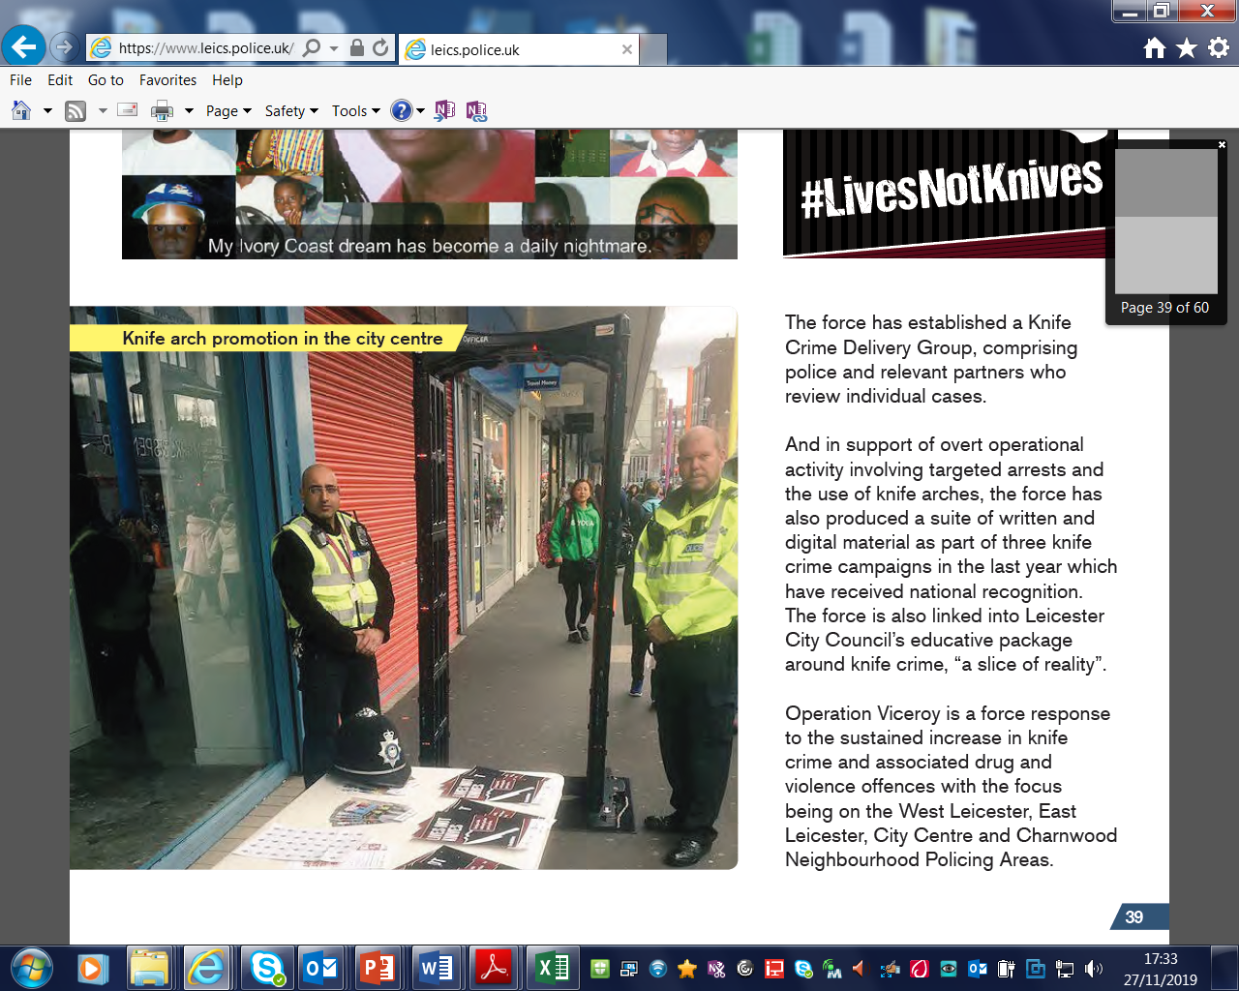
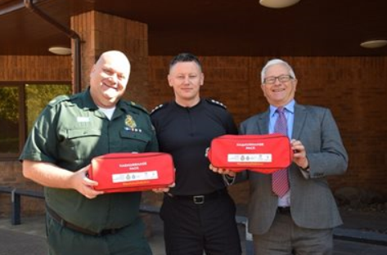
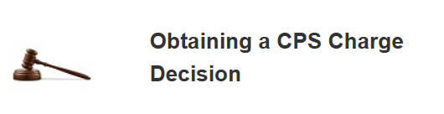
Serious Violent Crime Reduction Initiatives
Peer Educators
NTE Patrols
Knife Arches
Investigative Support
Trauma Packs

Slide 23
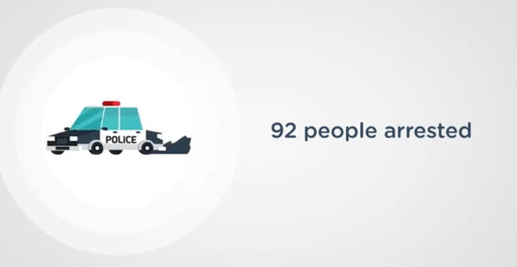
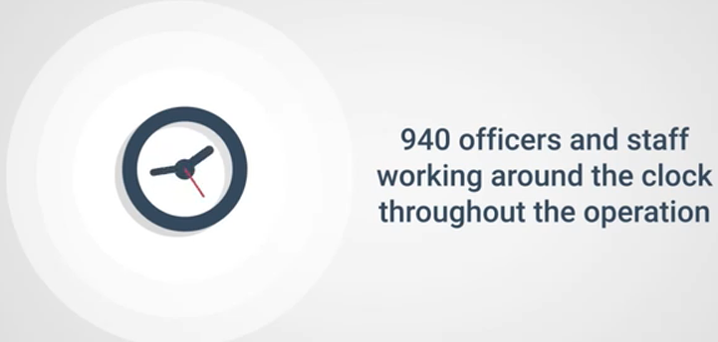
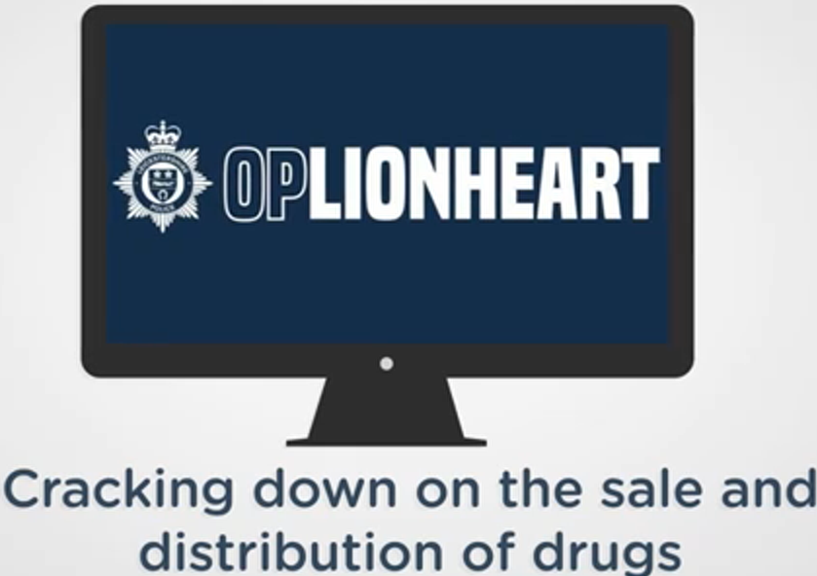
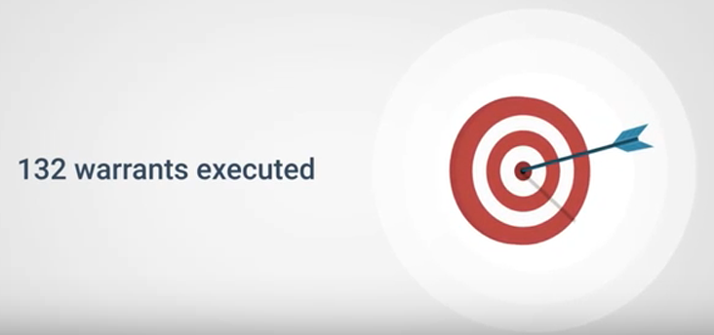

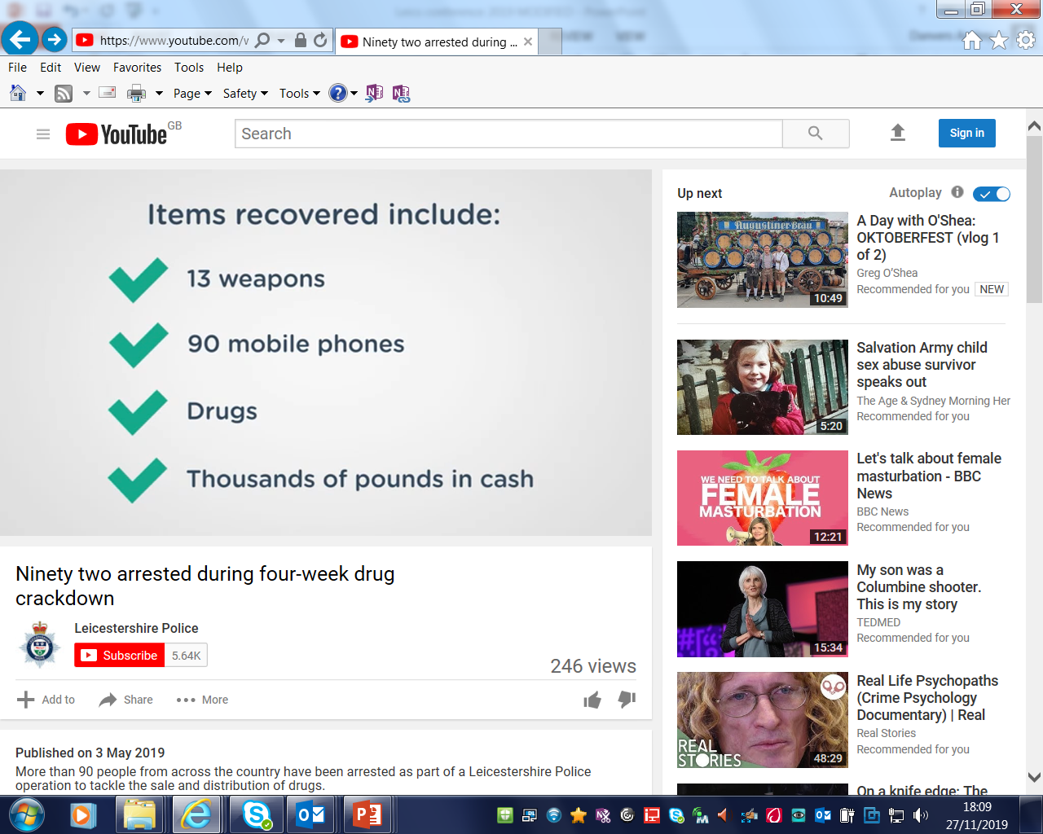
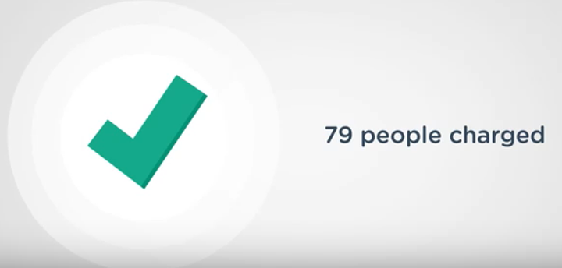
Operation Lionheart

Slide 24
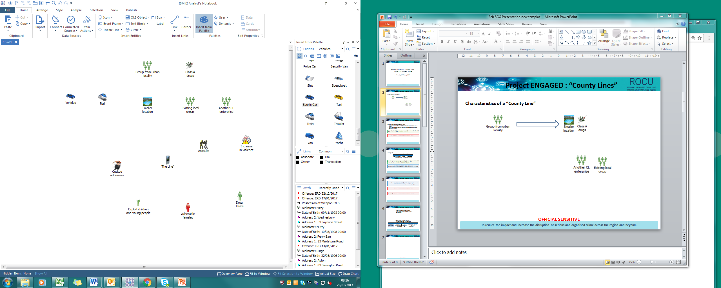
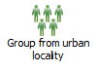
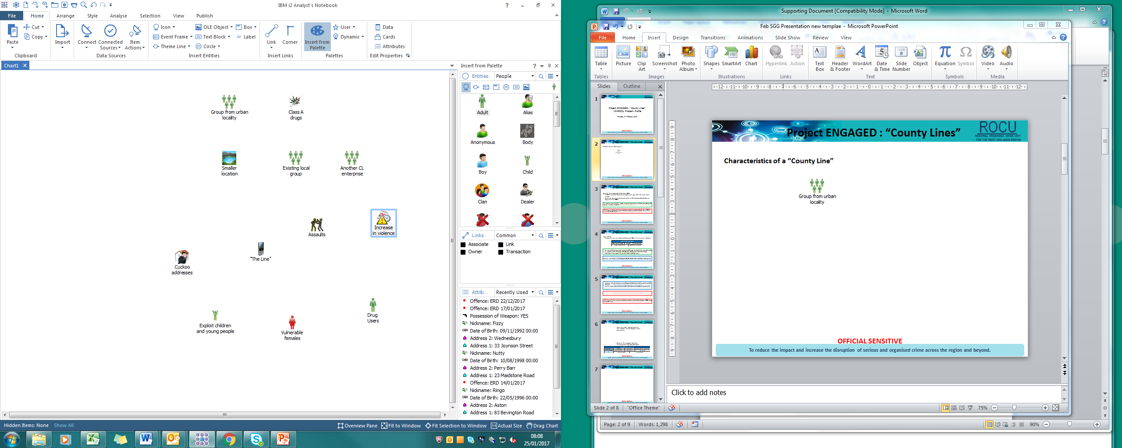
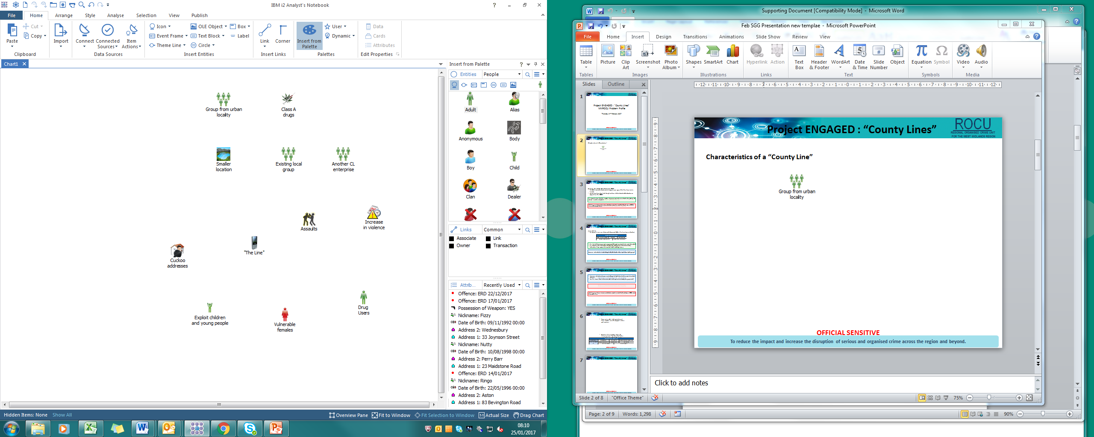
County Lines
County Lines
Urban Locality
Smaller Locality
VULNERABILITY / EXPLOITATION
Notes:
County Lines
County lines is a term used to describe gangs and organised crime networks involved in exporting drugs into one or more importing areas (within the UK) using dedicated mobile phone lines or other form of “deal line”. They are likely to exploit children and vulnerable adults to move (and store) the drugs and money and they will often use coercion, intimidation, violence (including sexual) and weapons.
Victims and Vulnerabilities
The current county lines business model thrives on the exploitation of vulnerable adults and children to move and deliver their drugs. This enables offenders to maximise their profits and reduce the risk of their criminal activity as it distances them from the supply transactions. Any vulnerability is a potential target, resulting in broad profile of victims of exploitation in county lines offending.
Data suggests potential victims aged between 11 and 56 years. However, the majority of referrals relate to victims between 15 and 17 years of old. Individuals in this age group are likely targeted as they provide the level of criminal capability required by the offending model and remain easier to control, exploit and reward than adults.
Offenders establish contact and build relationships with both male and female subjects before exploitation takes place. This means that children may have been approached before the age of 11 in some cases as offenders seek to build a relationship that may later exploit.
Children displaying vulnerabilities such as poverty, family breakdowns and intervention by social services, looked after status, frequent missing episodes, behavioural and developmental disorders and exclusion from mainstream schooling are frequently targeted by county lines offenders. It is likely that children displaying such vulnerabilities are attracted by the sense of belonging , inclusion and structure offered by participation in an offending group.
Children from seemingly stable backgrounds are also targeted by offenders who exploit vulnerabilities such as difficulties with parents and peer groups. Children without a criminal footprint are also targeted in an attempt to reduce attention from law enforcement.

Slide 25
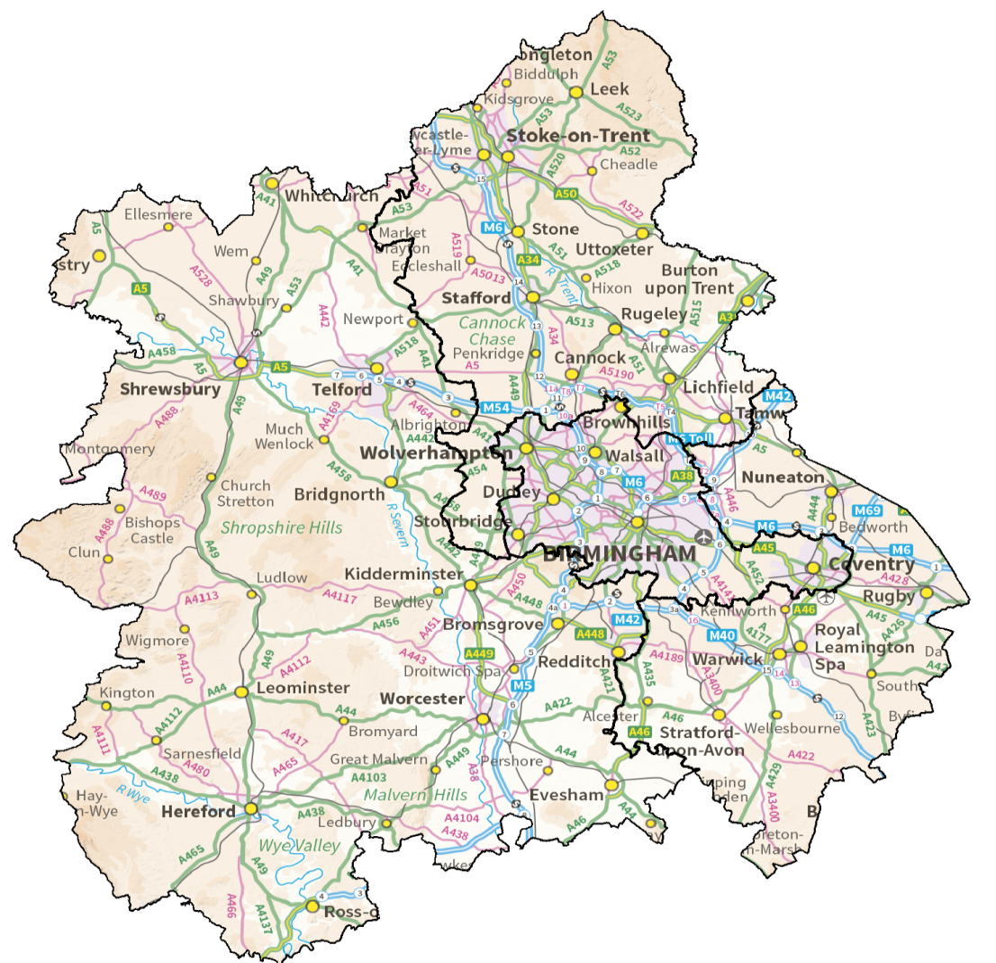
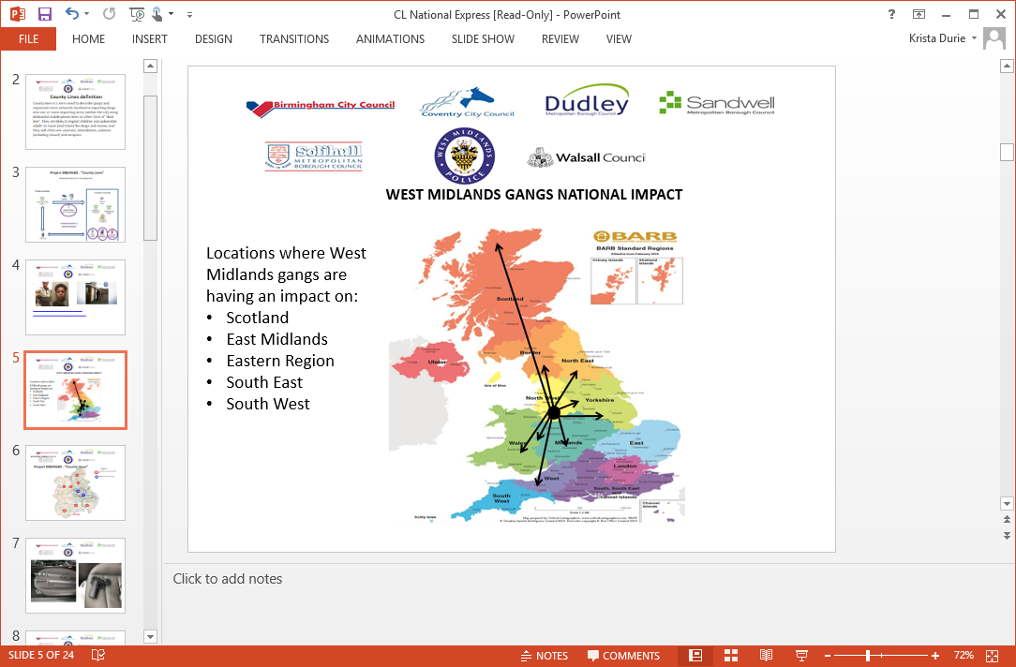
County Lines
County Lines
Notes:
Within West Midlands Policing area there are currently in excess of 100 county lines
Left Photo
Locations where West Midlands gangs are having an impact on:
Scotland
East Midlands
Eastern Region
South East
South West
Right Photo
Based on a combination of the x2 returns from the forces for the last problem profile – that is, intelligence indicates CL activity is present of has existed in these towns
Predicted towns are based on the common socio demographic and specific location factors.
County Lines Intensification Week
Very productive-widespread activity- VIBE
Regional JIC- locate/SIO/ Financial
Birmingham Children's Trust
Warrants/arrests/ANPR/enforcement Transport hubs & taxi licensing
Dismantled- Alom Line
Safeguarding and cuckooed addresses
Awareness raising and partner inputs
Increase in intelligence and CLICM
Right locations/ people/cannabis
73 arrests, 29 warrants, £18550 seized, 12 veicles, Safeguarded- cuckooed or engaged with 105 people, 54 weapons seized, over 80K worth of drugs, 30 schools input and over 250 joint partner activity and interventions.

Slide 26
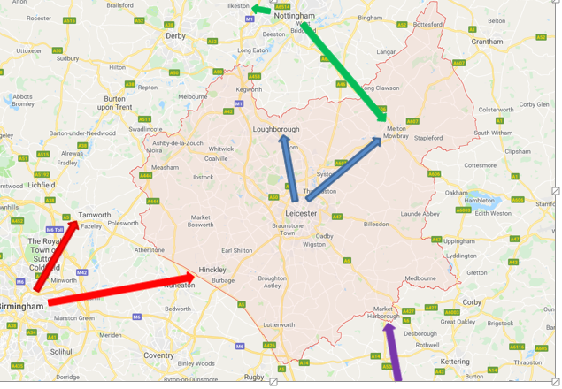
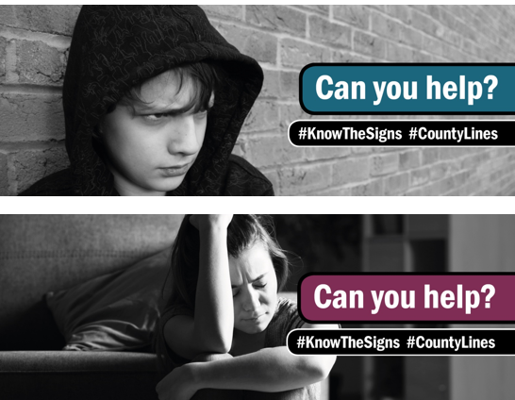
County Lines - Not Just Across County Borders
kkk

Slide 27
Summary
There is no silver bullet.
VRU addresses population level drivers of violence.
Police focus on weapon carriage, robbery, gang related / county lines.
Public involvement in policing and strategic solutions.

Slide 28
Voluntary & Community Sector Interventions

Slide 29
FR33DOM Zampaladus; The Urban Equestrian

Slide 30

THE URBAN EQUESTRIAN ACADEMY
cONNECTING INNER-CITY communities TO THE equestrian world

Slide 31

NEETZ RIDE TOO
Bespoke tailored course
WE RIDE TOO
Tailored provision on a Rolling contract HORSES

Slide 32
Program Details
An Equestrian Accredited Pathway program, aimed at 16-19 year olds who are not in education, employment or training.
Tailored bespoke courses using Equine Assisted Learning to aid personal development.
Young persons attending will learn all about horse equipment and clothing, caring for grass stable kept horses, horse health, livery yard duties and how to feed horses.
Members will also be introduced to equestrian establishments such as race yards, stud farms, events and competitions

Slide 33
Benefits
Studies show that Equine assisted learning for teenagers is very effective and Horse Therapy is not a new practice and has been used for hundreds, if not, thousands of years.
Program provides the freedom, the support and a safe, friendly environment for the opportunity to learn/grow.
Young people will also have the opportunity to further their education in Equine studies beyond this programme or will be supported into and through employment.

Slide 34
Accreditation
Young people will work with horses and receive a minimum unit of Level 1.
Build an accredited personal career portfolio (PCP) & Progressive Riding Certificate recognised by the British Horse Society (BHS).

Slide 35

NEETZ RIDE TOO

Slide 36
ACTIVITIES COVERED | The resources and equipment used | The learning outcomes and evidence collected
Site Tour Horse Riding Lesson/ Horse Care Session Youngstock Management Yard Management Theoretical/ Portfolio Session Visit to an Equestrian Establishment (Race Yard) Evaluation | Riding and Yard Equipment Equestrian Theoretical Exercises and materials Photographic Equipment | Timetable and ground rules understood Understanding of discipline required to complete equine assisted learning Familiarisation with staff and other young people Riding sessions Horses and History Horse Husbandry Riding and Road Safety Information on ‘Careers in the Equestrian Sector’
Evidence will be collected/ progress logged and photographic material collected for the duration of the programme

Slide 37
The motivation behind The Urban Equestrian Academy and everything that has been achieved to date can be found in FR33DOM’s autobiography.
An inspiring true story about the life of a kid from England who moved to Antigua and got caught up in the gangster lifestyle but escaped through training racehorses.
FR33DOM DELIVERS :
Workshops
Motivational Presentations
Appearances
For more information contact Team Urban Equestrian on:
E: info@urbanequestrian.co.uk
M: 07479708009

Slide 38
Rashid Bhayat; Positive Youth Foundation

Slide 39


Slide 40


Slide 41


Slide 42
James Gwilt; Catch-22

Slide 43
https://www.youtube.com/watch?v=8GFwHoAt6V8&feature=youtu.be

Slide 44
Question and Answer Session

Slide 45
Break…

Slide 46
Workshops:
You have a choice of the following…

Slide 47
Dr Angela Herbert MBE; Violent Crime Prevention Board
Identifying Hidden Community Interventions to Address Youth Criminality and Serious Violence

Slide 48


Identifying Hidden Community Interventions to Address Youth Criminality and Serious Violence
Dr Angela Herbert MBE
Chair of the Violent Crime Prevention Board, CEO Passion Project Foundation
Anthony Peltier
Education Lead of the Violent Crime Board, COO Passion Project Foundation
29 November 2019

Slide 49
Aims: Identify community interventions that could address youth criminality and serious violence
Objectives:
Awareness of the cause of youth criminality and serious youth violence
Consider approaches that may contribute to ceasing youth criminality and violence
Identify ‘hidden’ interventions provided by the community
Consider how to engage with community provision
Understand the Violent Crime Prevention initiative, it’s purpose and objectives

Slide 50


Slide 51
Questions
In all communities, initiatives are delivered by third sector or other organisations to help prevent violent crime. How might these be identified?
If you are aware of initiatives, what are they called?
What services do those initiatives provide?
How can you ensure that the quality of services that are provided?
How might you engage with these services?

Slide 52

How deep does it go?

Slide 53


Slide 54
The Violent Crime Prevention Board (VCPB) Launched on 26 September 2018; consists of a team of experienced professionals, community influencers, police and practitioners in the area of addressing violent crime; it signals a new and powerful approach to facilitating the prevention and reduction of violent crime in London and the United Kingdom.

Slide 55
VCP Themes
Parents and Family
Police
Education
Health and Mental Health
Business
Stop and Search
Youth Engagement
Faith

Slide 56





VCP Themes
Also…
Physical and Mental Health
Employment
Research
+ Partnerships which include
Guinness Partnerships, Army, RAF, Royal Navy, MOPAC, Police Constabularies, Churches, IAGs. Local Authorities, Banks, Third Sector,
Kick Off@3, JC Education and Sport…..

Slide 57








Community Organisations Revealed

Slide 58


Empowering Youth
Young people are at the core of the work that we do, understandably because they are the most affected by violent crime today.
The VCPB recognises that 98% of young people are engaged in positive activities. 2% require intervention – the VCPB are therefore using professionals like ourselves to champion our young ambassadors.
VCP Ambassadors and Champions
Empower, Inspire, Motivate, Drive.

Slide 59
Identify community interventions that could address youth criminality and serious violence
At the end of this workshop
Do you have an awareness of the cause of youth criminality and serious youth violence?
Have you considered approaches that may contribute to ceasing youth criminality and violence?
Are you aware of how to identify ‘hidden’ interventions provided by the community?
Do you have ideas about how to engage with community provision?
Do you understand the Violent Crime Prevention initiative, it’s purpose and objectives?

Slide 60
Steve Clarke; St Giles Trust
The power of lived experience

Slide 61
Vicki Morris; Centre for Justice Innovation
Point of arrest diversion: a practical guide to the most successful models

Slide 62




Slide 63




Overview
What is youth diversion
Why Diversion?
The Research Evidence
The Economic Case
Core principles
Journey of the child

Slide 64

What is youth diversion?
Point-of-arrest diversion schemes address low-level criminal behaviour without putting young people through the formal criminal justice system – either out of court disposal or prosecution – that can result in a criminal record, labelling, and other negative consequences.
Diversion involves a short assessment and light-touch, voluntary programming.

Slide 65

Out Of Court Disposal framework

Slide 66

The Journey of a Child

Slide 67
Context
Significant reduction in FTEs:
  Between April 2017 and March 2018, there were 14,000 FTEs to the YJS. An 86% reduction over 10 years and 14% lower than the previous year.
  Diversion is partly to thank:
  Compared to those entering the system in 2007/08, FTEs in 2018/18 were, on average: more likely to be older (aged 15 to 17 years); less likely to be female; and more likely to have committed a more serious offence.

Slide 68
Why Diversion?
Most young people engage in risky or illegal behaviour at some point.
For some, risky behaviour leads to contact with the police.
But the vast majority of these young people will not go on to become escalating or prolific offenders.

Slide 69

Why Diversion?
A first offence is not a reliable signal of a future criminal career.
Most young people grow out of crime.

Slide 70
Why Diversion? - A legislative and policy perspective
The principle aim of the Youth Justice System is to prevent reoffending (s37 CDA 1998)
2. There is a duty to consider the welfare of the child (s44 CYPA 1933)
3. The best interests of the child is a primary consideration (Art 3(1) of The United Nations Convention on the Rights of the Child)
The Charlie Taylor Review referred to the “tainting” effect of the experience of the criminal justice system
Disproportionality of certain young people in the criminal justice system (looked after children and BAME)

Slide 71
The Research Evidence
Formal justice system processing makes young people more likely to commit crime again.
Youth diversion generates a range of positive outcomes for matched groups compared to formal criminal justice processing.

Slide 72




The Research Evidence
These findings have held up in the UK and internationally.
Justice system processing for the wrong population is counter-productive.

Slide 73
Effective Practice
What we don’t know:
  At what point do the benefits of diversion diminish?
  How do causal mechanisms interact?
  Which specific models and strategies work best?
This should not be a barrier to implementing diversion, but should spur us to find out more.

Slide 74
The Economic Case
Youth diversion is more cost effective than standard system processing:
  “Immediate” cost avoidance
  Reductions in reoffending
  Earlier access to supports for health, mental health, and other social service needs

Slide 75
The Economic Case
Formal justice system processing is an expensive investment, often with poor returns:
  £3,620: Estimated average cost of a first time entrant (under 18) to the criminal justice system in the first year following the offence
  £22,995: Estimated average cost of a first time entrant (under 18) to the criminal justice system, nine years following the offence
  £113,000,000: Estimated savings if one in ten young offenders were diverted toward effective support

Slide 76
Effective Practice
Core principles:
  Minimise labelling: do not stigmatise young people, and guard against formation of deviant/delinquent identities;
  Avoid net-widening: ensure that schemes operate as an alternative to the formal system, not as a supplement to it; and
  Do not overdose young people: programming should generally be targeted, therapeutic, and light touch.

Slide 77
Activity
Read the three scenarios and answer the following:
Are they eligible for diversion?
If so, what interventions would be suitable and who should deliver them?

Slide 78
Our work
The impact of diversion is better understood.
  A national roster of schemes
  BAME diversion research project
  Influencing paper and event
2. Schemes are better informed about what works.
  Quarterly bulletin
  Evidence & practice briefings
  Practitioner workshops
3. Ultimately diversion is better and more widely practiced.
  Practice support offer to individual schemes
  Our new tools for practitioners

Slide 79
Get in touch
Vicki Morris, Deputy Director
  vmorris@justiceinnovation.org
Claire, Head of Innovative Practice
cely@justiceinnovation.org
Twitter: @cjinnovation @vicki_CJI

Slide 80
StreetGames
An integrated approach to reduce youth violence using the critical success factors of an effective sport intervention

Slide 81
An Integrated Approach to Reduce Youth Violence using the Critical Success Factors of an Effective Sport Intervention

Slide 82
https://www.youtube.com/watch?v=zeMba_1rQOM

Slide 83
Sport & the VRU
Shifting the Dial
Diversion Desistence

Slide 84
Risk Factors
vs
Protective Factors
Notes:
Video

Slide 85
https://www.youtube.com/watch?v=YiMjTzCnbNQ

Slide 86

Critical Success Factors
Phase One: Foundation
Clear Ethos
Multi-agents/Partnerships
Phase Two: The Offer
Right Staff
Right Style and Place
Right Young People
Phase Three: Maintaining Engagement
Rewards/Rewarding
Attractive Offer
Personal Development Opportunities
Sustained Delivery
Phase Four: Maximising Impact - Sport Plus
Positive Pathway
Phase 3: Maintaining Engagement

Slide 87
Critical Success Factors
Phase One: Foundation
Clear Ethos
Multi-agents/Partnerships
Phase Two: The Offer
Right Staff
Right Style and Place
Right Young People
Phase Three: Maintaining Engagement
Rewards/Rewarding
Attractive Offer
Personal Development Opportunities
Sustained Delivery
Phase Four: Maximising Impact - Sport Plus
Positive Pathway
Phase 3: Maintaining Engagement

Slide 88
Critical Success Factors
Phase One: Foundation
Clear Ethos
Multi-agents/Partnerships
Phase Two: The Offer
Right Staff
Right Style and Place
Right Young People
Phase Three: Maintaining Engagement
Rewards/Rewarding
Attractive Offer
Personal Development Opportunities
Sustained Delivery
Phase Four: Maximising Impact - Sport Plus
Positive Pathway
Phase 3: Maintaining Engagement

Slide 89
Critical Success Factors
Phase One: Foundation
Clear Ethos
Multi-agents/Partnerships
Phase Two: The Offer
Right Staff
Right Style and Place
Right Young People
Phase Three: Maintaining Engagement
Rewards/Rewarding
Attractive Offer
Personal Development Opportunities
Sustained Delivery
Phase Four: Maximising Impact - Sport Plus
Positive Pathway
Phase 3: Maintaining Engagement

Slide 90

Literature Review

Slide 91

Engaging the Right Young People

Slide 92
Prevention
Early Intervention
Rehabilitation
Notes:
Prevention
Early Intervention
Rehabilitation

Slide 93
Contact Details
National DoorStep Sport Advisor
Email: graham.helm@streetgames.org
Mobile: 07976253469
StreetGames Area Director – Midlands
Email: jenny.carter@streetgames.org
Mobile: 07776691194
West Midlands VRU Sport Lead
Email: aaron.northmore@streetgames.org
Mobile: 07956057386

Slide 94
Lunch and Networking…

Slide 95
A Mothers Perspective:
Cheryl Armatrading;
Antoin Akpom Achievements Foundation

Slide 96

ANTOIN AKPOM ACHIEVEMENTS FOUNDATION
CHALLENGING BEHAVIOURS CHANGING LIVES

Slide 97


Slide 98

AAA FOUNDATION YOUTH VIOLENCE EARLY INTERVENTION & DIVERSION
Introduction
Who I am
The Impact on my life as a mother who lost a child through street violence
Challenges
The Charity

Slide 99
AAA FOUNDATION YOUTH VIOLENCE EARLY INTERVENTION & DIVERSION
Aim & Objective
Identify & Address Challenging Behaviours
Identify Triggers & Influences, Impact, Cause & Affect
Grooming & Radicalisation
Reviewing measures that can be put in place to reduce violent crime caused by young people
Acting as an alternative intervention platform
Safe guarding

Slide 100

AAA FOUNDATION YOUTH VIOLENCE EARLY
INTERVENTION & DIVERSION
Crime Breakdown Leicester

Slide 101



ANTOIN AKPOM ACHIEVEMENTS FOUNDATION
COST ON SERVICES

Slide 102
AAA FOUNDATION YOUTH VIOLENCE EARLY
INTERVENTION & DIVERSION
Action:
Conduct a case study looking at behaviour traits dissecting negative historical cultural behaviours, building layers to restore organic positive relationship to collectively rebuild communities
Social Describing – Collectively agencies forge partnerships to address issues and source solutions, Polices, Local Authorities, Housing Associations, Service Agencies, Grassroot organisations all working in consultation with young people.

Slide 103
AAA FOUNDATION YOUTH VIOLENCE EARLY
INTERVENTION & DIVERSION
ANTOIN AKPOM ACHIEVEMENTS FOUNDATION
CHALLENGING BEHAVIOURS
CHANGING LIVES
CREATING A BRIGHTER FUTURE FOR YOUNG PEOPLE OF TOMORROW

Slide 104
West Midlands Violence Reduction Unit – video

Slide 105
Violence Reduction Unit Overview:
Intervention and Diversion
Claire Dhami; Head of Implementation, West Midlands VRU
Grace Strong; Strategic Director, Leicestershire VRN

Slide 106
Violence Reduction Units
Grace Strong
Director of the Leicester, Leicestershire and Rutland
Violence Reduction Network
Claire Dhami
Director of the West Midlands Violence Reduction Unit
Notes:
GS

Slide 107
Background
April 2018: The government published the Serious Violence Strategy focusing on the root causes of violence and with an emphasis on early intervention and prevention
April–May 2019: Force areas allocated Home Office surge funding to strengthen their responses to serious violence
June–July 2019: The Home Office identified 18 areas across E&W with the highest levels of hospital admissions for knife-related injuries and invited applications for funding to establish local Violence Reduction Units (VRU)
Both areas successfully applied for grants (West Mids = £3,370,000;
LLR = £880,000) to be spent by 31 March 2020
Notes:
GS

Slide 108
Home Office Expectations
Establish a VRU to deliver the core function
Produce a Response Strategy
Spend 20% of the grant on interventions
Adopt a public health approach
Produce a Strategic Needs Assessment
Participate in the national evaluation
Core Function: To offer leadership, establish a core membership and, working with all relevant agencies operating locally, provide strategic coordination of the local response to serious violence.
Notes:
GS

Slide 109
Definition of violence
“The intentional use of physical force or power, threatened or actual, against oneself, another person, or against a group or community, that either results in or has a high likelihood of resulting in injury, death, psychological harm, maldevelopment
or deprivation”
(WHO, 2002)
... encompasses all forms of violence and exploitation
… concerns itself with groups vulnerable to violence, that is,
children and young people, and vulnerable adults.
Notes:
CD

Slide 110
Why are we treating serious violence
as a public health issue?
An important cause of ill-health through fear, injury and loss affecting individuals and communities
Communicability: clusters of incidents linked in time, by place or by the groups of people affected
Distributed unequally across population groups and contributes to health inequalities
Risk factors for violence overlap with risk factors for other adverse physical and mental health outcomes
It has root causes, it can be treated,
it can be prevented
Notes:
CD

Slide 111

Common Risk & Protective Factors
Avoiding bombarding people with separate issue after issue.. yesterday CSE, today knife crime, tomorrow teenage partner violence
Understanding the commonalities can help strengthen our work (particularly prevention) and avoid silos
Notes:
CD

Slide 112

The Public Health Approach to Violence
as outlined by the WHO
Violence Prevention Alliance. WHO. Available from: https://www.who.int/violenceprevention/approach/public_health/en/ . Accessed 10 January 2019
Notes:
CD

Slide 113

What do we mean by Prevention?
Notes:
GS

Slide 114
The West Midlands
Violence Reduction Unit
Notes:
CD

Slide 115
Mobilising across the West Midlands – guiding principles for our regional multiagency partnership
Violence is unacceptable. We are determined to see an end to the misery caused by violence for individuals, for families, for communities and for society.
We are taking a stand together because violence is not inevitable, it is preventable. Everyone has a part to play and can make a difference
We will build violence prevention partnerships with young people and communities at their heart and galvanising the public, private and VCSE sectors.
By working together, taking a public health approach to prevent violence we will work hard to understand what’s really causing the problem. By working together to tackle the causes of violence we can stop violence before it starts, intervene early to stop it escalating, and stop violence blighting lives.
Notes:
CD

Slide 116
Vision
Diverse & Inclusive Communities Living Safe and Fulfilling Lives
“We will look, listen, co-design, explain or reform”
Citizens, communities, public, private and third sector are key to improving outcomes
Mission Statement
Together, with our partners and communities, we will:
Stop violence before it starts
Tackle the cause and impact of violence
Focus on enabling safe futures for our children
Reduce violence in the West Midlands
Recognise the diversity of the challenge we face across the region.
Notes:
CD

Slide 117
Public Health Approach
Violence Prevention Alliance (VPA)
Preventing Violence against Vulnerable People Alliance (PVVP)
Learning from the Gangs and Violence Commission
Learning from best practice elsewhere – e.g. Glasgow
Partnership Working/ Coproduction
Notes:
CD

Slide 118
Working with our communities & partners to reset social norms
Data, intelligence, governance
Strong Foundations
Primary Prevention
Secondary Prevention
Tertiary Prevention
Enforcement & Criminal Justice
Attitudinal Change
VRU
Prevent further violence for those in the CJ system
Stop violence before it starts; tackle root causes
Rehabilitate; alternatives to criminalisation
Stop the progression of violence - early detection and intervention
Notes:
CD

Slide 119

Notes:
CD

Slide 120

vru@west-midlands.pnn.police.uk
@WestMidsVRU
0121 626 6060
Notes:
CD

Slide 121
The Leicester,
Leicestershire and Rutland
Violence Reduction Network
Notes:
GS

Slide 122
Our Initial Focus
To prevent and reduce youth violence (under 25)
and in particular serious youth violence in public spaces including knife crime.
Over time we intend to broaden out our focus not least because the evidence indicates:
Victims who have experienced one form of violence are likely to experience other forms of violence
People who are violent in one context are likely to be violent in other context(s)
Different forms of violence share common consequences
Different forms of violence share common risk and protective
factors
Notes:
GS

Slide 123
The VRN’s Mission
To achieve ‘prevention through connection’ by building an inclusive, collaborative and courageous network which will drive the short and long-term change required to successfully tackle the causes and consequences of violence across the lifetime.
Notes:
GS

Slide 124
The VRN’s Approach
connected relationships
connected communities
connected leadership
connected data
connected policy
Prevention through Connection
connected services
connected workforce
connected learning
Notes:
GS

Slide 125
Structure and Governance
VRN Central Team
VRN Programme Board
VRN Development Group
Community Advisory Panels
THE NETWORK
The VRN Programme Board is accountable to the Strategic Partnership Board
via Exec and reports progress to other LLR Partnership Boards.

Slide 126
Our Initial Priorities
Improve our understanding of violence locally & it’s root causes
Ensure communities & those most affected by violence are fully involved
Develop existing services & test new ones
Develop & share models of effectiveness
Understand our collective strengths & current gaps
Build momentum & commitment for change through campaigns & distributed leadership
Notes:
GS

Slide 127
Examples of our work
New Violence Intervention Project in A&E
Grassroots community grant scheme and co-design of community mentoring
Schools Project
Adverse Childhood Experiences/Trauma Informed training programme
Reshaping of Engage, our early intervention offer for young adults
Investment in Community Leaders
Street Mediators project
Scoping of integrated perpetrator programme
New partnerships (for example, The Curve)
Notes:
GS

Slide 128
Thank you!
Follow us:
    @WestMidsVRU
    @VR_Network
Notes:
GS

Slide 129
Question and Answer Session

Slide 130
Kirk Master; Leicestershire Deputy Police & Crime Commissioner
Close:

Slide 131
Thank you and goodbye…
Friday 29th November
Ricoh Arena, Coventry
@WestMidsVRU
@VR_Network

