Slide 1
JARAP
Cybercrime
D/Inspector Phil Tebbs –
Cybercrime Implementation Lead

Slide 2
Recognition of the Cyber Threat
November 2011 – UK Cyber Security Strategy
July 2012 – Strategic Policing Requirement Report
February 2014 – HMIC initial 2014 Inspection
Late 2014 – Local assessment
Notes:
November 2011 – UK Cyber Security Strategy to make UK Cyberspace safer place
July 2012 –strategic aim to “identify and understand threats, risks and harms and ensure a proportionate and effective response including across force boundaries”
February 2014 – HMIC completed initial inspection: Significant and persistent gaps at local level. Most forces not addressing the full range of cyber and online crime types.
Local assessment recognised the need to support the use of digital media within ‘traditional’ crimes and incidents.

Slide 3
Cyber Capability Development
Cyber Capabilities Development Plan written in 2014 highlighting need to:
  Provide effective response to growing threat of Cybercrime
  Ensure exploitation of digital investigation opportunities
  Ensure confidence in Leicestershire Polices investigation/interaction.
Notes:
Providing effective response to growing threat of Cybercrime and improve exploitation of digital investigation opportunities.
Enabling the organisation to proactively pursue Cyber Crime in order to reduce the threat, risk and harm posed to the public
Ensuring this response embraces the ethos of continuous improvement and continual professional development and to keep pace with the expected expansion of the threat posed by Cyber Crime in the wider sense.

Slide 4
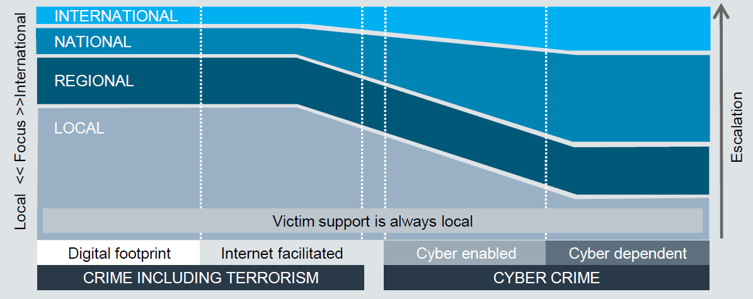
2014 Workflow expectation for Cybercrime Investigation
Notes:
Not met locally.

Slide 5
Cyber Capability Development Timeline
Inception
9th February 2015 – 8 Digital Media Investigators recruited
10 Objectives created to improve day to day policing of cybercrime
Now
Policy and Procedure to enable access to DMI team skills/support.
3 Phase communications strategy
Next Steps
DMI lead review of current working practice.
Creation of links to academia (DMU) to research impact of cybercrime on local businesses.
DMI team accredited and trained in multi-source exploitation analysis.
Using data from Serious and Organised Crime Segmentation Initiative to identify risk groups.
Notes:
10 objectives:
- real-time & proactive support – targetting most harmful and most vulnerable – OCG Digital profiling
- highlight roles and responsibilities of the DMI
training and communication strategy in line with regional delivery – MCCT – OSINT – Including where/how and what resources needed
produce profile of the scope impact on Leicestershire (region)
create of infrastructure and governance around Leicestershire’s approach to dealing with identified Cyber Crime
Now:
Central team training around cybercrime investigation and the means to exploit digital opportunities.
Policy and procedure in place to ensure staff are able to access these skills to support daily business.
Comms strategy includes: Internal communications, First communicator training, External comms
Cybercrime profile for the Leicestershire area created to identify true scope of impact
Next Steps:
DMI review within specialist investigation teams:
Identify appropriate software to:
automate current processes to allow earlier identification of victims and suspects.
streamline investigations.
Risk Groups: Schools/Universities, Businesses, Individuals

Slide 6
Future Development Priorities
Develop communication and training strategy to improve:
  Information sharing
  Ability of front line staff to investigate cybercrime
  Organisational ability to exploit multiple data sources
  Develop local capability cognisant of the national picture including:
    UK Cyber Security Strategy 2014
    National Police Chief’s Counsel paper representing the Digital Investigation and Intelligence Portfolio produced in April 2015.
Notes:
Improve organisational ability to exploit data:
Relevant software to automate extraction and exploitation of vast data sets
Skilled staff to interpret and analyse the results produced
UK Cyber Security Strategy 2014 – Report on progress and forward plans particularly around toolkits designed specifically for businesses.
3 key recommendations and 7 priorities within the NPCC’s Paper

Slide 7
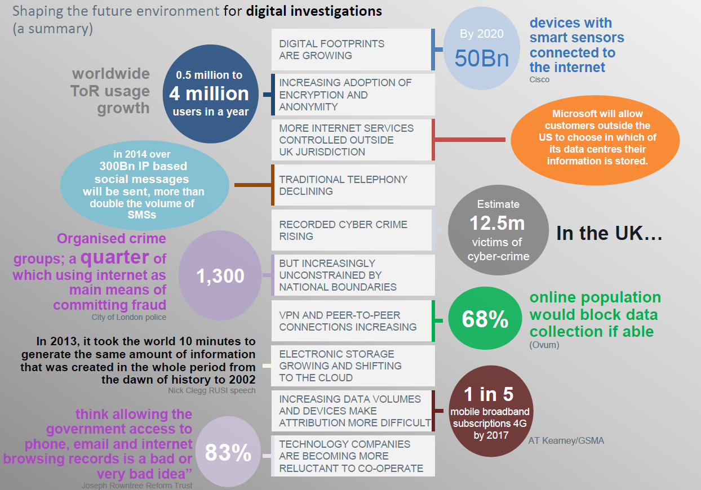
Notes:
2013/14 figures. Increasing every year.

