Slide 1




Leicestershire Police EDIC Strategy
Pursuit of Excellence
Vernal Scott
“The Police are the Public, and the Public are the Police” - Sir Robert Peel
leics.police.uk
Notes:
The PCC’s Crime Plan and the EDIC Strategy are in alignment
“The Police are the public, and the public are the police”

Slide 2

Leicestershire Policing Culture
Notes:
Learning outcome 2.1 & 3.1

Slide 3

PCC Police & Crime Plan and EDIC
Notes:
LP strategic priorities for this coming period are:
• Improving service and standards
• Finding efficiency and productivity
• Investing in the right people with
the right skills and wellbeing
• Maximising the best technology
• Reducing demand by working
alongside partners

Slide 4

​PCC’s Themes
​
​ ​
1. Prevention Focuses on stopping crime before it happens rather than only responding after harm occurs. Recognises that factors such as poverty, exclusion, poor health, educational disadvantage and social inequality can contribute to vulnerability and offending. Requires strong partnerships with local authorities, health services, schools, probation and voluntary organisations. An EDI approach means ensuring prevention strategies reach all communities, including those who may traditionally have less trust in public services. 2. An Efficient and Effective Police Force Seeks to ensure Leicestershire Police has the people, technology and resources required to meet modern policing demands. Prioritises visibility, responsiveness and public confidence. Effective policing depends on a workforce that reflects the communities it serves and treats people fairly and consistently. EDI contributes through inclusive recruitment, retention, leadership, wellbeing and the reduction of discrimination and bias. 3. Supporting Victims and Witnesses Ensures victims receive appropriate support and are treated with dignity and respect. Places particular emphasis on vulnerable people and those at greater risk of harm. An EDI lens recognises that experiences of crime, reporting, and access to support can differ for women, disabled people, minority ethnic communities, faith groups, LGBTQ+ people and other protected groups. Services should therefore be accessible, culturally competent and tailored to individual needs. 4. Preventing and Tackling Crime and Harm Focuses on violence, serious crime, neighbourhood safety and road safety. Targets offenders and behaviours causing the greatest harm to communities. Supports an intelligence-led approach that identifies criminality wherever it exists, without stereotyping or stigmatising particular groups. Emphasises protecting communities from hate crime, exploitation, abuse and other forms of harm.
Notes:
The EDI message within the PCC Plan is that effective policing depends upon fairness, inclusion, community trust, protection of vulnerable people, prevention of harm and meaningful engagement with Leicester, Leicestershire and Rutland's diverse communities. EDI is therefore not a separate agenda, but a key enabler of legitimacy, public confidence and policing excellence.

Slide 5
​
PCC’s Themes (cont.)
​
​ ​
5. Community Voice and Participation The PCC emphasises listening to communities and involving them in identifying problems and solutions. This supports inclusion, representation and co-production with diverse groups. 6. Partnership and Collective Responsibility Safer communities cannot be delivered by policing alone. The Plan promotes collaboration across health, local government, education, voluntary organisations and communities themselves, reflecting the EDI principle that social inclusion is a shared responsibility. Summary The principal message within the PCC’s Plan is about effective policing, underpinned by fairness, inclusion, community trust, protection of vulnerable people, prevention of harm and meaningful engagement with Leicester, Leicestershire and Rutland's diverse communities. EDIC is not a separate add-on, but an integral enabler of legitimacy, public confidence and policing excellence.
Notes:
Trainer to introduce this slide explaining that to serve well, and to protect with understanding and empathy, we first need to know our communities well, and their diverse cultures, needs, and aspirations.
Leicestershire Police want to embed EDIC principles and values into our professionalism.

Slide 6
EDIC (Equality, Diversity, Inclusion & Cohesion)
Making the Case:
The Legal Case – The Equality Act 2010 is an opportunity rather than a threat. The consequences of failing to deliver as required include unlimited fines, severe reputational damage, poor staffing and community relations, etc.;
CoP/LP Policing Values Case – Transparency, Impartiality, Integrity, and Competent Public Service – we cannot be competent without being truly inclusive
The Moral and Ethical Case – “The police are the public…” and “policing with consent”… Providing inclusive community policing and employment opportunities for diverse applicants is simply the right thing to do;
The Business Case – Attracting and retaining the best possible talent, including that offered by the county’s diverse communities. Ideally, we want to not just employ more diverse talent, but to make sure they are employed at all ranks, staff grades, and voluntary roles;
The Equal Life Chances Case – Enabling equal life opportunities for everybody and comparing and reducing inequalities between different groups; such as disabled and non-disabled people, older and younger people, heterosexual and LGBTQ+ people, people of different ethnicities, health or wealth status, etc. The way in which we police can and does affect life chances.
Notes:
Making the general case for EDIC in policing

Slide 7

Notes:
Embedding organisational and procedural justice within the workplace:
Challenging discriminatory behaviour and attitudes, racism, sexism and misogyny
Clarity about inappropriate

Slide 8
One Leicestershire Values Statement
“Leicestershire Police enable a professional culture underpinned by respect, integrity and dignity for all. We have pledged to deliver our duty to protect vulnerable people, prevent crime, bring people to justice and deal with those who cause the most harm.
We will deliver our legal obligations with dedication, commitment and compassion, and strive to become the number one employer of choice for diverse talent, whilst earning the trust, confidence, and consent of the diverse communities that we are privileged to protect and serve.”* – Chief Constable David Sandall
*Regardless of age, colour, disability, education, ethnicity, gender, marital status, nationality, parental or maternity status, political perspective, religion, belief, sexuality, health status, or socio-economic status.

Slide 9
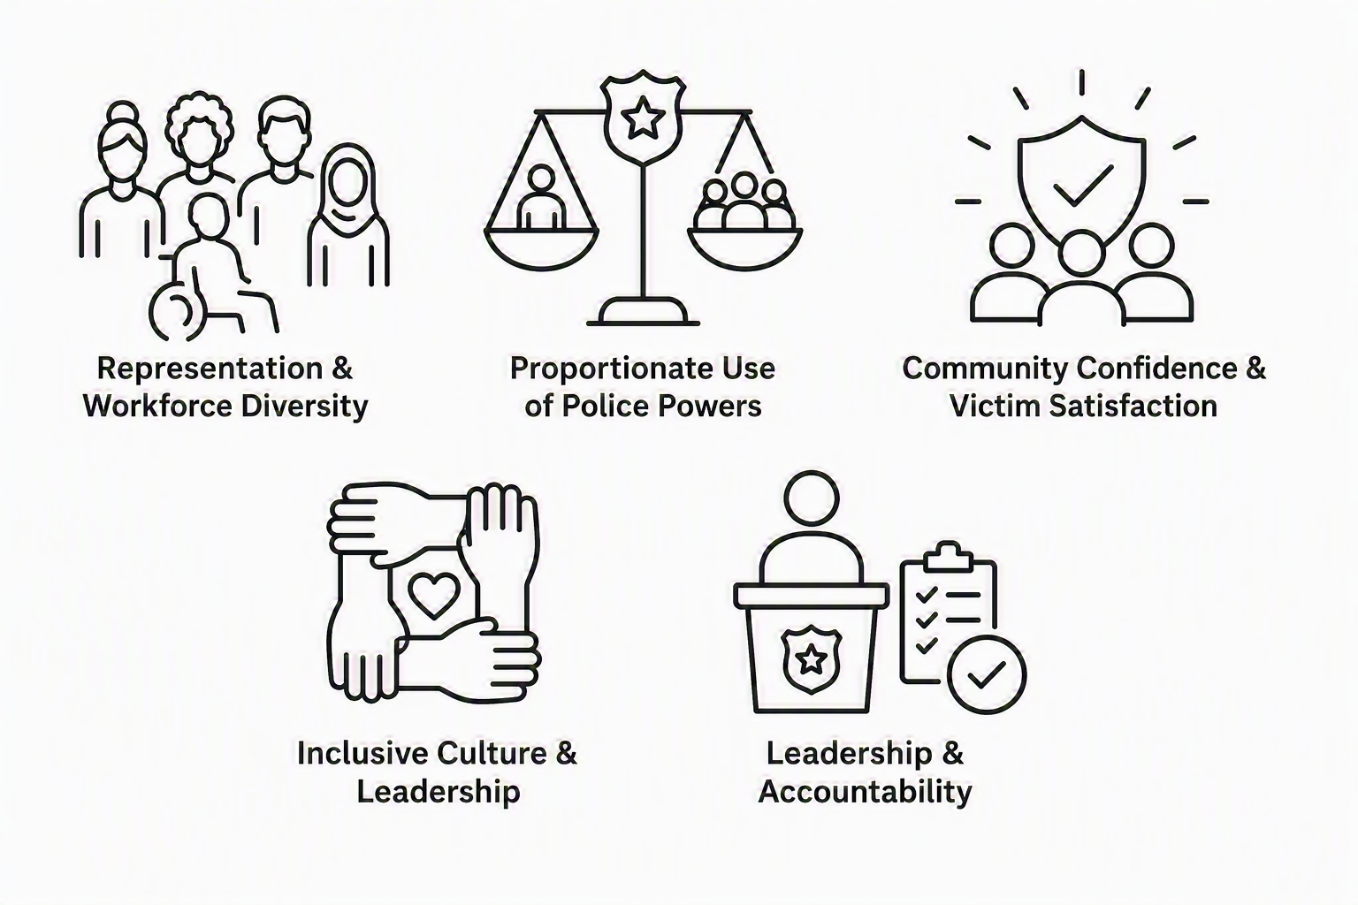
Leicestershire Police EDIC Strategy 2025-30
Attract, recruit, progress and retain a skilled workforce that reflects the diversity of Leicester, Leicestershire and Rutland communities
Achieve national recognition by embedding EDI into everyday policing practice, governance and decision-making
Leadership & Accountability
Representation & Workforce Diversity
Inclusive Culture & Leadership
Proportionate Use of Police Powers
Reduce disparities in the use of police powers and criminal justice outcomes while maintaining public safety and strengthening community cohesion
Community Confidence & Victim Satisfaction
Create a respectful, equitable workplace culture where dignity is promoted and discrimination is eliminated.
Increase trust, confidence and satisfaction among victims and communities through fair, responsive and inclusive policing
Notes:
EDIC Board
Cascading conversations
EDIC slide deck, began rolling out to students and leaders

Slide 10

Embedding EDIC Values into Policing Professionalism
Understand the relevance and importance of Equality Legislation and the EDIC strategy
Identify how to incorporate EDIC values into everyday policing best practice
Explain the key principles, legislation and concepts relating to equality, diversity and inclusion
Recognise roles and responsibilities in upholding and promoting the values, culture and reputation of Leicestershire Police when engaging with colleagues, partners and communities
Recognise the diverse experiences, perspectives and community considerations of: Asian, Black, Jewish, White and Gypsy, Roma and Traveller (GRT)
Understand the role of community engagement and cohesion in supporting inclusive policing, strengthening community relationships and enhancing public trust and confidence
Identify the Leicestershire Police staff networks available to support all personnel, including those with protected characteristics, and understand the role they play in promoting inclusion, wellbeing, representation and a positive workplace culture
Notes:
Trainer to provide brief overview – All covered in more detail during session

Slide 11

Our Organisation – Progress
EDIC Strategy launched on 30th December 2025
EDIC/DIFB board established (chaired by CC David Sandall)
A dedicated Positive Action Team lead officer
EDIC Comms plan in development
SCOT session held
Glossary of EDI and Disability terminology produced
Ongoing development of staff support networks e.g. Men’s Forum
External engagement active e.g. Envoy Church, NHS, etc.
EDIC training/learning offer in progress
Disability Confident – leadership ambitions

Slide 12
Our Organisation – Progress 2
Community scrutiny panels established
Victims’ voice panels active?
EIA regime active
PRAP principles active
CC led meetings held to discuss the NPCC Inclusion and Race Plan
Dedicated EDI team established
Active partnership working
Zero tolerance
Evidence = Leicestershire Police is emphatically anti-racist!
Ambition: Elimination of discrimination-related ET’s and grievances

Slide 13
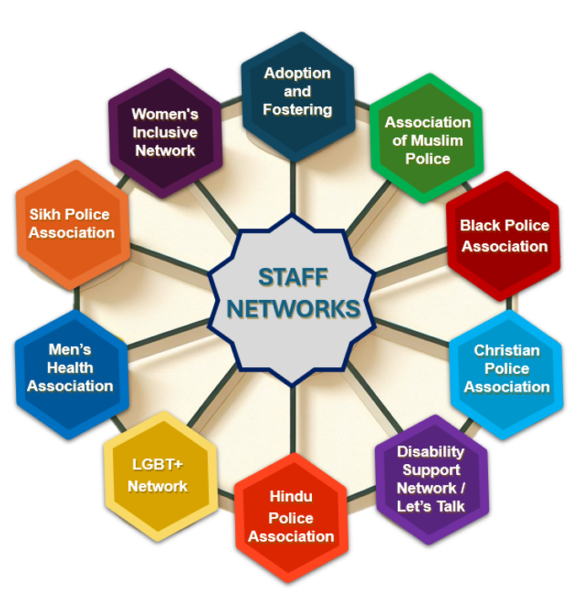
Notes:
Staff networks
Trade Unions
Federation
Chaplaincy

Slide 14



Responsibility
Equity
Service
People
Engagement
Challenge
Trustworthiness
Leicestershire Police
Pursuit of Excellence
Q&A

